Slide 1
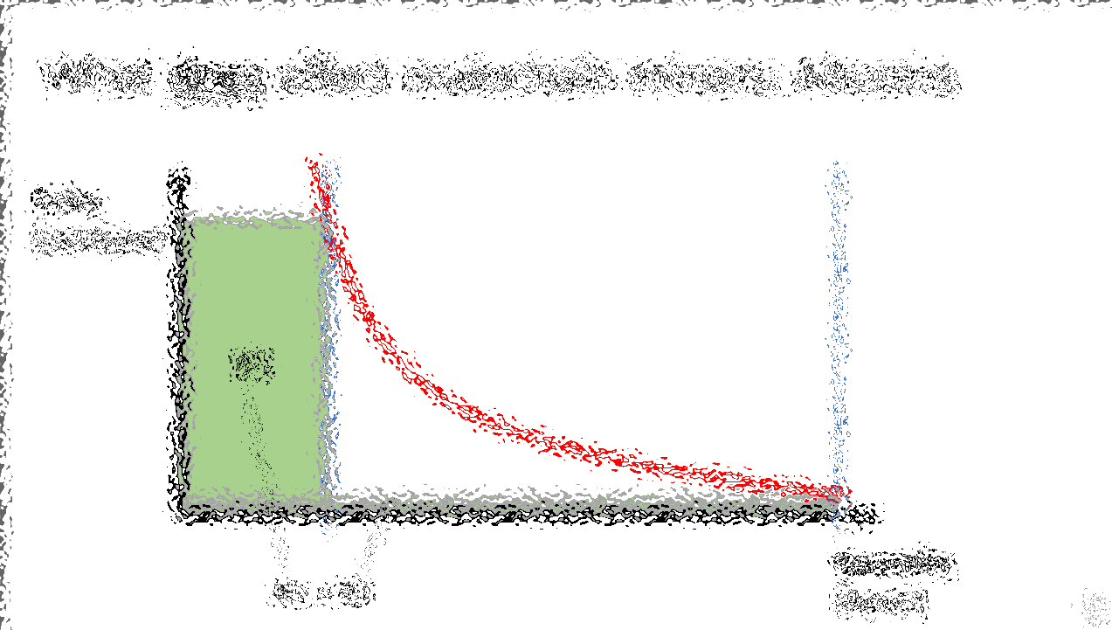
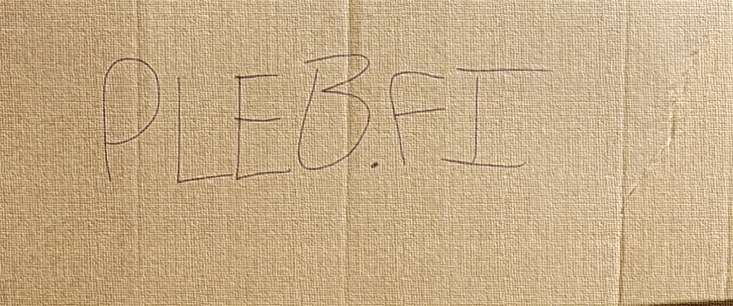
Drivechains (BIP 300 + 301)
Paul Sztorc
May 16th, 2023
MIAMI
Notes:
TRANSCRIPT OF SPEECH, 11/5/2021: Okay, hello. I’ve been invited to speak about Bip300 ... which is one of my ideas for taking Bitcoin to the next level. ...

Slide 2
Agenda
Paul Sztorc / LayerTwo Labs
BIP 300 – A Bold Claim
I will quickly show you all the other slides:
Details of the Bold Claim -- Heterogeneity, Namecoin, Truthcoin
Prison Metaphor
Actual zCash Example w/ Screenshots
The BIP – The Six Messages of BIP 300 , Explained
Theory: How to Police a [Chain] We Can’t See
Two Critiques of Bip300
Appendix: Fees
Q&A – You tell me, what if anything , you actually want to see.

Slide 3
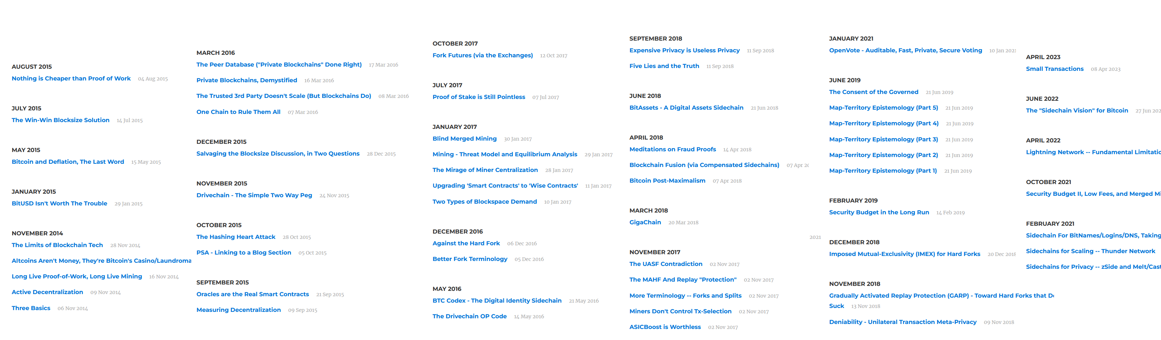
Paul’s 1000+ Pages About Bitcoin

Slide 4
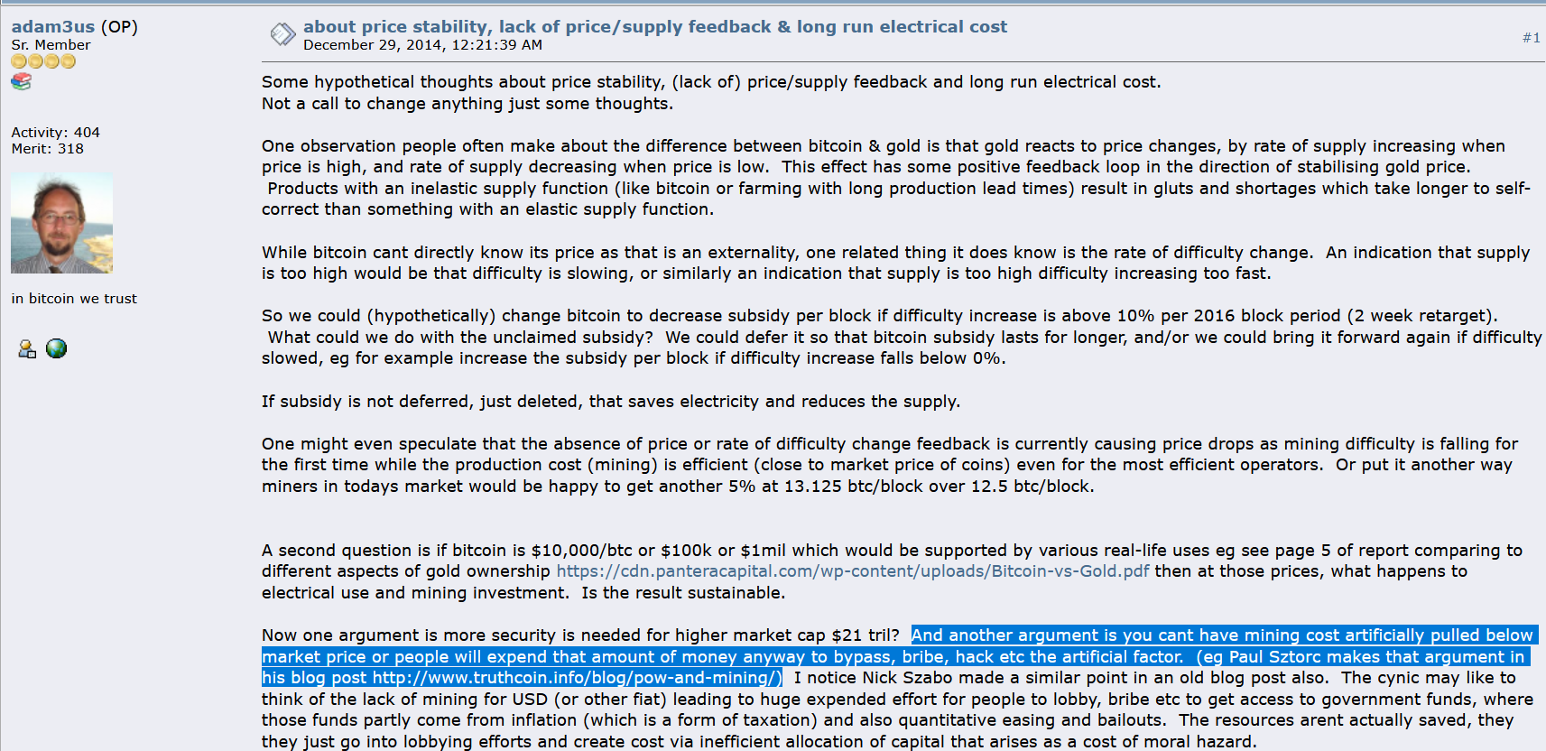
My Big Break
Adam Back links to my blog – Dec 2014

Slide 5
Since Then
Wrote “Truthcoin” whitepaper (decentralized oracle)
Technical Talks
Scaling Bitcoin 1 2 & 3 -- Program Committee for #4
TabConf every year – keynoted in 2018
Bitcoin Wednesday – all around the globe (Toronto, Chicago, Amsterdam, etc)
BitDevs – Summer 2014 (NYC), Austin (May 2018)
Consensus Construct (2017, 2019); American Banker ; Qcon London (2017)
Bitcoin Miami 2019/2021/2022/2023 & Amsterdam
Wrote BIPs 300 and 301.
Countless Podcasts
Financially Stable ....and therefore loyal to Nobody!! Bwahaha!!
(My loyalty is to Bitcoin only.)

Slide 6
Part 2 – Why Bip300
My Three Favorite Endorsements
"Drivechains…are pretty cool…and arguably could have been more important or useful than let’s say Taproot.“ - Adam Back, Baltic Honeybadger 2022, Live on stage in front of everyone
“We need Drivechain or all the work of thousands in the last 13 years will be in vain.” ... “Drivechain is our only hope”. - fiatjaf, (creator of nostr), on twitter
“We need your project, of course, for the obvious reasons...” - Rene Pickhardt ( Author of Mastering Lightning , #1 stackoverflow (?) contributor for LN questions ), MIT Bitcoin Expo, 2023
Visit www.LayerTwoLabs.com/friends for 47 more!
Notes:
These people all *Lead* a different project. Adam Back leads Blockstream and thus indirectly Liquid. Fiatjaf leads nostr. Rene is one of the leaders of LN.
Yet they all found some nice things to say about my project.
What can I say, kids – real respects real.

Slide 7
A Bold Claim
BIP300 Solves All of Bitcoin’s Biggest Problems
Heterogeneity Problem
Scalability
Privacy
Scams – Eliminating ScamCoins ; Domesticating the Token Casino
Security Budget
Decentralization
“Fundamental Value” of Bitcoin
With...
...zero risk to Bitcoin!

Slide 8

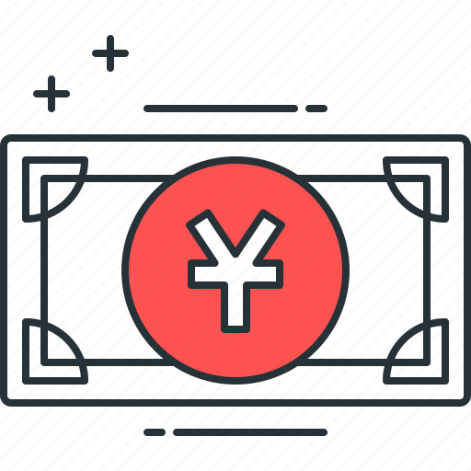

BIP300: Everything on Top of Bitcoin
zCash
FileCoin
ETH
VISA
WeChat Pay
ETH
zCash
FileCoin
BTC Today
WeChat Pay
VISA
BTC + Drivechain
Today ☹
Tomorrow ☺
Notes:
What is BIP300 about ??

Slide 9
BIP300: Everything on Top of Bitcoin
zCash
FileCoin
ETH
VISA
WeChat Pay
ETH
zCash
FileCoin
BTC Today
WeChat Pay
VISA
BTC + Drivechain
Today ☹
Tomorrow ☺
Notes:
6

Slide 10
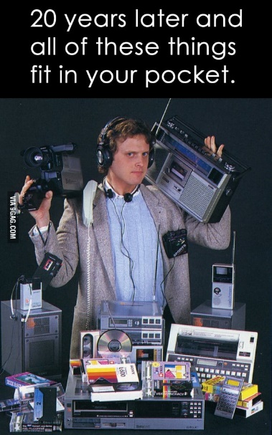


The Coming Death of Bitcoin’s Competitors
WeChat Pay
VISA
ETH
BTC Today
zCash
BTC + Drivechain
* Network effects of Money * Universality of Computation
* Tech/Culture Kick People Out
FileCoin

Slide 11
Drivechain = Altcoin Tech, BTC Coin Only
“Drivechains”
n
n
Bit-Ethereum
Bit-Monero
Bitcoin
Ethereum
Monero
Bitcoin
Bip300
Bip300
BIP 300
Ethereum
Monero
Notes:
Bip300 proposes these new layer2s, that some call “sidechains”. Sidechains are a response to the threat of Altcoins, but they’re also a response to the desire of Bitcoiners for creativity, and innovation – -- you know: the desire to try new things without asking for anyone’s permission. How can we let everyone try the ideas that they like? And how do I keep other people’s bad ideas away from me? So here you see we have the world of Altcoins on the left, but then, the revenge of Bip300 on the right. We have copied Ethereum and Monero into our own projects that respect the 21M coin limit of BTC. No inflation.

Slide 12
Details of the Bold Claim

Slide 13
A Bold Claim
BIP300 Solves All of Bitcoin’s Biggest Problems
Heterogeneity Problem
Scalability
Privacy
Scams – Eliminating ScamCoins ; Domesticating the Token Casino
Security Budget
Decentralization
“Fundamental Value” of Bitcoin
With...
...zero risk to Bitcoin!

Slide 14

A. Heterogeneity
Smart Contracts DeFi Turing Completeness Ring Signatures zk-Snarks Large Blocksizes
NFTs Oracles
Mimblewimble
…(etc)
Bitcoin does seem great… but can it do _______ ?
Actually we DON’T want Bitcoin to do ______ in the first place because it is actually a bad due to _______, as you can read ______. But if by ______ you really mean ______, then yes Bitcoin can do that! Eventually we are working on _____ which should be able to do ______ even better than ______ anyway but it is actually a good thing that the protocol is so difficult to upgrade beca …
Yes. See BIP 300.
Noob
Bitcoiner
Notes:
Ideally, with Bip300, if some annoying person asks “Sure Bitcoin seems great, but can it do .... smart_contracts, DeFI, zk-snarks, blah blah, you just say “Yes, Bitcoin can do that – see Bip300”.

Slide 15
A. Heterogeneity
I can improve Bitcoin! It only needs my new idea: _______ !! When can you merge my code ??
You can’t just merge something into Bitcoin -- It affects everyone else’s nodes!! Besides, ______ has been proposed before and you need to read ______ so that you can learn why everyone hates it, especially our infallible _______ who would have done it by now if it were a good idea. ________ is a SCAM and you are trying to ATTACK BITCOIN!! Even if your idea was good it would probably take years to get consensus and get merged into …
Noob (and/or Fringe Genius)
Use BIP 300.
Good luck!!
Bitcoiner
Notes:
Similarly, if some innovator dreams up a crazy idea, “Hey I can improve Bitcoin, it only needs my new idea ... larger blocksizes, Turing Completeness, KYC-miner-coins?” Then: similarly, they now can do that without anyone’s permission. They just don’t do it on Bitcoin base layer, they do it on a Bip300 sidechain.
So: that’s the goal – FREEDOM. Developers can write whatever code they want, users can use that code if they like. Everyone gets what they want. But how is it accomplished?

Slide 16
Why Hasn’t Bitcoin Already Conquered the World?
Time
2009 | 2011 | 2013 | 2015 | 2017 | 2019 | 2021 | 2023
Initial Growth P
Blocksize War
Today
Orthodox Interpretation
Network-Effect Interpretation

Slide 17
Why Hasn’t Bitcoin Already Conquered the World?
Time
2009 | 2011 | 2013 | 2015 | 2017 | 2019 | 2021 | 2023
Initial Growth P
Blocksize War
Today
It takes time!
S**tcoins exist because of moral defects (“greed”, scams, bad marketing).
Culling of the Weak
Unreliable allies were purged
Demonstrates our Commitment to Decentralization
Orthodox Interpretation
Network-Effect Interpretation

Slide 18
Why Hasn’t Bitcoin Already Conquered the World?
Time
2009 | 2011 | 2013 | 2015 | 2017 | 2019 | 2021 | 2023
Initial Growth P
Blocksize War
Today
It takes time!
S**tcoins exist because of moral defects (“greed”, scams, bad marketing).
Culling of the Weak
Unreliable allies were purged
Demonstrates our Commitment to Decentralization
Orthodox Interpretation
Complacency / Flippening / Uncertainty that Bitcoin is “the one”.
People like the features and cheap fees of other blockchains.
Network-Effect Interpretation
Community no longer a welcoming / pro-growth place.
Gave pretext / justification to Ethereum / other competitors.
Demonstrates our abandoning our core mission (world domination, “bitcoin vs the banks”), so that we can play internal political games amongst ourselves.

Slide 19
A Bold Claim
Different strokes for different folks.
BIP300 Solves All of Bitcoin’s Biggest Problems
Heterogeneity Problem
Scalability
Privacy
Scams – Eliminating ScamCoins ; Domesticating the Token Casino
Security Budget
Decentralization
“Fundamental Value” of Bitcoin
With...
...zero risk to Bitcoin!
Different chains for different users.
A team of region-specific chains, each with a large growing Blocksize – onboard users directly to L2.
zCash drivechain.
Have a dedicated NFT/ERC/Ordinals chain. Pay all txn fees in BTC. Clear coin roles.
Merged Mining = miners collect ALL fees from ALL chains. For free.
Shrink L1 Bitcoin Core Blocksize, and ossify (the spec at least). No more politics.
Chains are actually useful for real world tasks.
BitNames + Truthcoin ; examples

Slide 20
That “Zero Risk” Part
Bip300 is an easy soft fork to add to Bitcoin... And an easy soft fork to remove.
Bitcoin Core v25
BIP 300 Softfork
New Bitcoin Core
Interoperable with Core v25
A Softfork Banning all Bip300 Deposits/Withdrawals from L1
Bitcoin Core v25
New Bitcoin Core
Interoperable with Core v25
So, worst case scenario, miners just run a simple softfork, and we are exactly back to where we are today.

Slide 21
A Bold Claim
BIP300 Solves All of Bitcoin’s Biggest Problems
Heterogeneity Problem
Scalability
Privacy
Scams – Eliminating ScamCoins ; Domesticating the Token Casino
Security Budget
Decentralization
“Fundamental Value” of Bitcoin
With...
...zero risk to Bitcoin!
Different chains for different users.
A team of region-specific chains, each with a large growing Blocksize – onboard users directly to L2.
zCash drivechain.
Have a dedicated NFT/ERC/Ordinals chain. Pay all txn fees in BTC. Clear coin roles.
Merged Mining = miners collect ALL fees from ALL chains. For free.
Shrink L1 Bitcoin Core Blocksize, and ossify (the spec at least). No more politics.
Chains are actually useful for real world tasks.
BitNames + Truthcoin ; examples
Notes:
We don’t have time for all of these, but in the Q&A perhaps we can get back to them. However, I will go deeper into

Slide 22
Scalability – Comparison to LN
* I assume that an automated hot-wallet is out of the question!
 | Lightning N. | LB Drivechain
Onboard without Layer-1 | No | Yes
Receive Payments while Offline* | No | Yes
Recover Wallet From Seed | No | Yes
Unlimited Liquidity | No | Yes
Option to use SPV Mode | No | Yes
Reckless | Yes | Yes
Txn Settles Instantly | Yes | No
…the primary advantage of LN is fast settlement, especially when both buyer and seller are online. So, LN probably best for in-person retail; DC better for online shopping, perhaps.
Notes:
I have some extra specific

Slide 23
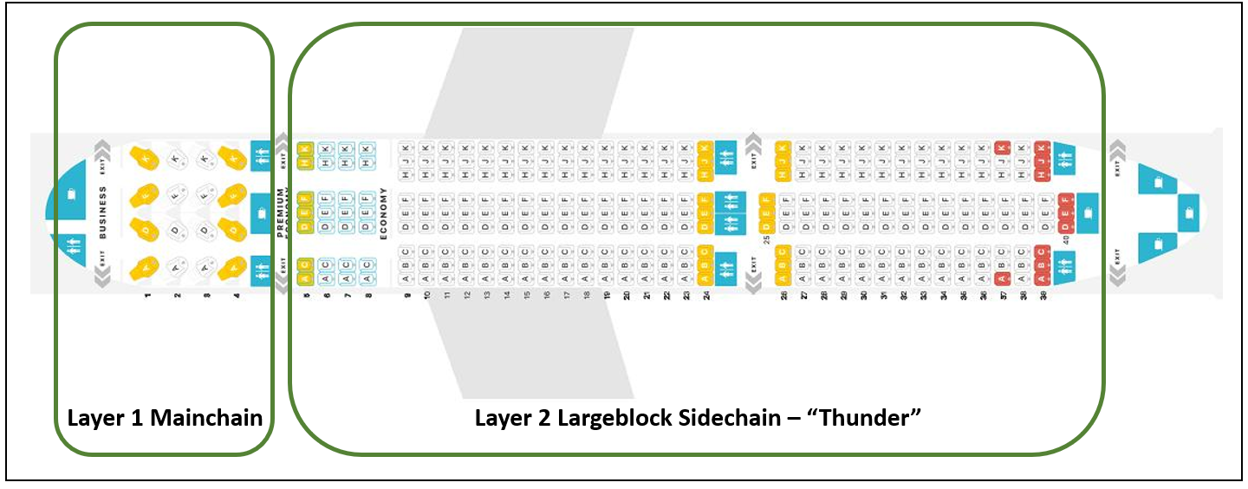
LargeBlocks?? What about Decentralization??
A Scalability Paradigm Shift
Remember: Heterogeneity! People are different! “Coffee txn” does not need as much decentralization as other txns. Bitcoin must compete, today, with Venmo.

Slide 24
Fundamental Value – Namecoin
Satoshi co-invents Namecoin in 2010
Why does today’s internet suck so much??
Namecoin Enables:
One Username – Own a single username, that works everywhere, on every site.
No more passwords! -- Login by being “pinged” with PIN via open protocol.
Easy to keep different online identities separate.
“PayMail” – Special inbox where people must pay you $ in order for the message to go through.
PayMail for introductions + Whitelists = eliminates all spam from the internet. This breaks the chokehold of Google.
On-chain PayMail is completely, 100% untraceable if you run a full node. No TOR required.
Everyone has end-to-end encryption. Everyone has a TOR / i2p website.
No seizing of ICANN domain names.
(Through Bip47 / similar), eliminates the need for Bitcoin addresses.
Notes:
In other words, Satoshi would have an email address, a zCash address, and an Instagram account and a TikTok, automatically.

Slide 25
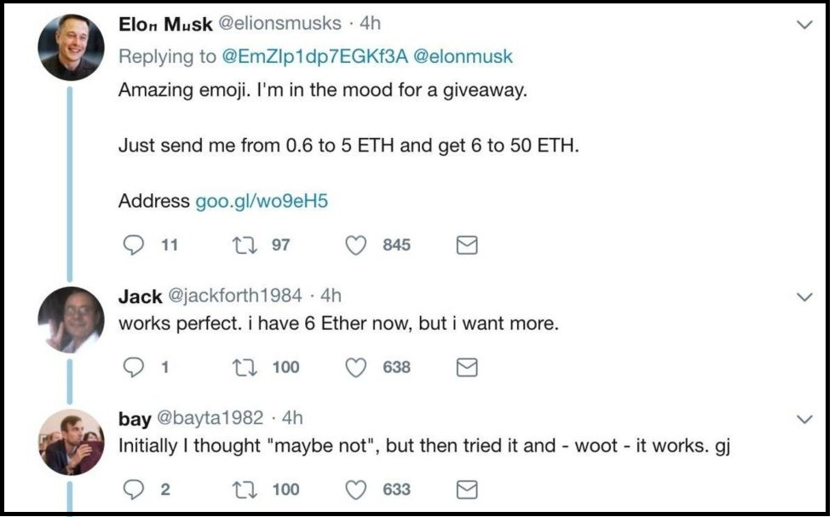
Screenshot #1 from www.truthcoin.info/blog/bitnames/
Notes:
…this is someone pretending to be Elon Musk, on Twitter…

Slide 26
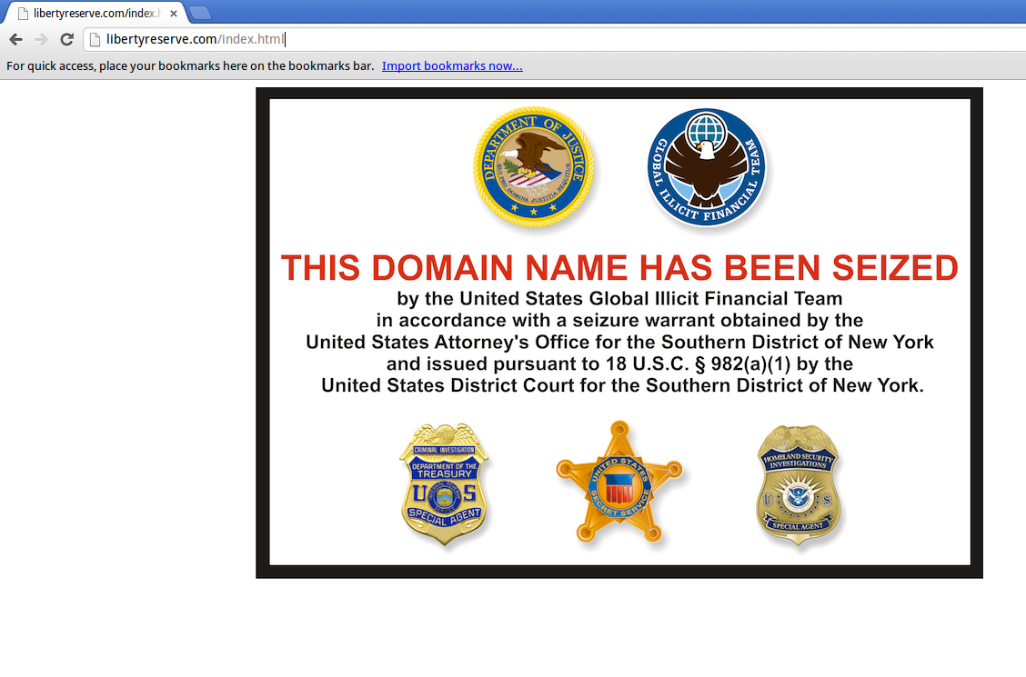
Screenshot #2 from www.truthcoin.info/blog/bitnames/
Notes:
…this is the Liberty Reserve website domain_name being seized…

Slide 27
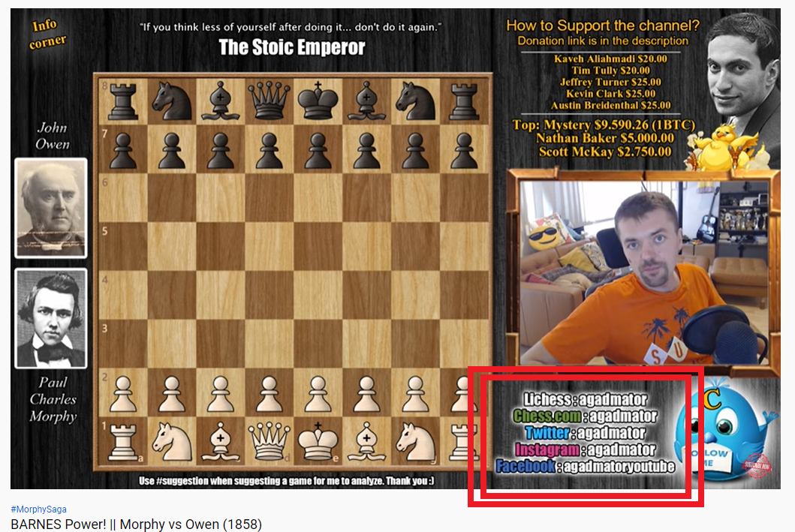
Screenshot #3 from www.truthcoin.info/blog/bitnames/
Notes:
…this is a guy on YouTube who, in the bottom-right, has to list out all of his screennames ... and they aren’t all identical, his Facebook name is different. With BitDNS everyone would just have one login, for every service. No one could seize your account, anywhere. And people would always be able to find you.

Slide 28
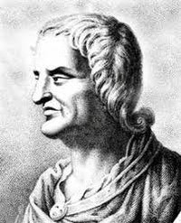

Fundamental Value – Truthcoin
Paul (me) invents Truthcoin in 2013/14
Why does today’s internet suck so much??
Truthcoin Enables:
Prediction Markets – prevents politicians/CEOs from lying.
Prevents politicians/CEOs from lying
Each voter/shareholder/whatever can become optimally informed, with zero effort.
Will counteract “rational ignorance” and Caplan-esque “rational irrationality”.
Eliminates the entire “misinformation” pipeline / food chain. (Lobbyists, pollsters, etc).
Thus, politicians will have to work as hard as possible.
Fork futures -- would have prevented the Blocksize war.
Portfolio replication – allows for stablecoins/anything-coins... no backer needed!
Paves the way for land-value-Futarchy / nirvana.
Quis custodiet ipsos custodes? – “But who is in charge of those who are in charge?”
Notes:
In other words, Satoshi would have an email address, a zCash address, and an Instagram account and a TikTok, automatically.

Slide 29
Rot From Above: Who controls what?
Informed or otherwise…
CEO / President / Senator / Editor-in-Chief
Group Opinion
C-Suite / Cabinet /
Coordinators / Reviewers
Managers / Directors /
Aides / Researchers
Shareholders /
Voters / Colleagues
Staff / Research Assistants
Result
Satisfaction of: Customers / Citizens / Readers

Slide 30

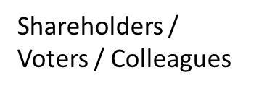
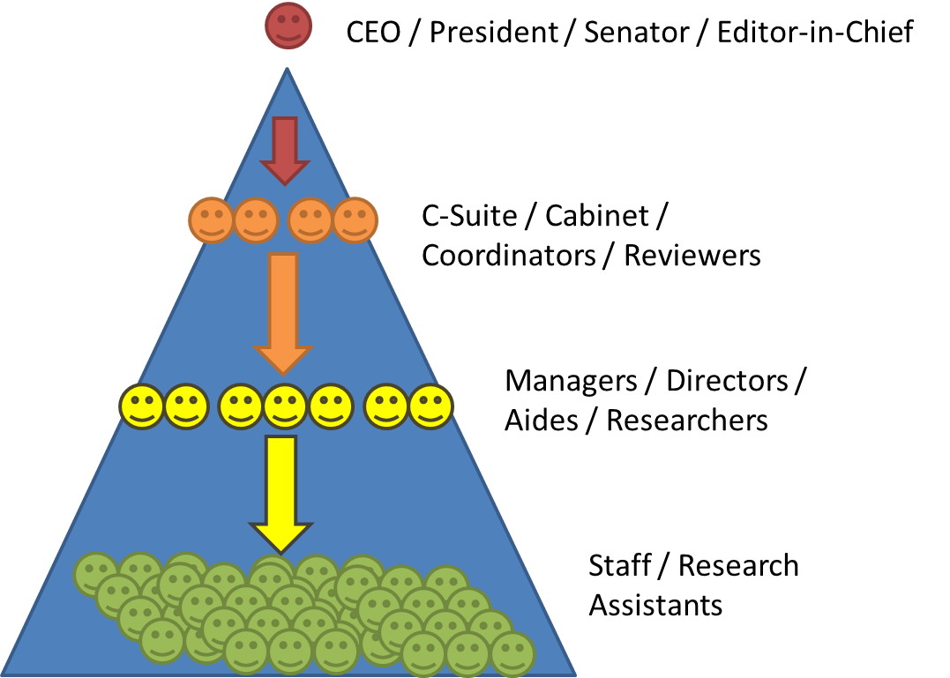
How to we combine the many preferences of this group into one request?
Do we each have to monitor the leader’s work? If not, who do we trust (and why)?
If I don’t like this leader, how do I find out if others agree? How do we fire the leader?
Bad
Prediction Markets fix this.
Can easily…
…make requests.
…observe work/results.
…fire insubordinates.
Good
Quis custodiet ipsos custodes? – “But who is in charge of those who are in charge?”

Slide 31
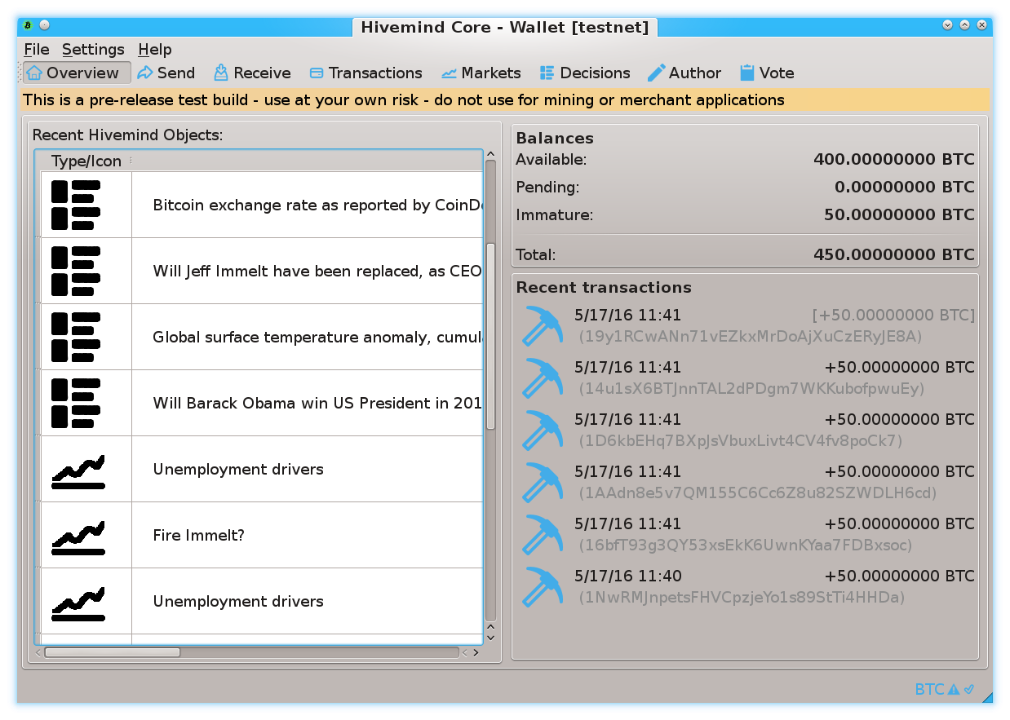
Prediction Markets
Screenshots from my own BTC sidechain project
www.BitcoinHivemind.com
Notes:
This is one of my other projects, BitcoinHivemind.com, check it out. I designed it to be a sidechain from the very beginning. Here are some screenshots…

Slide 32
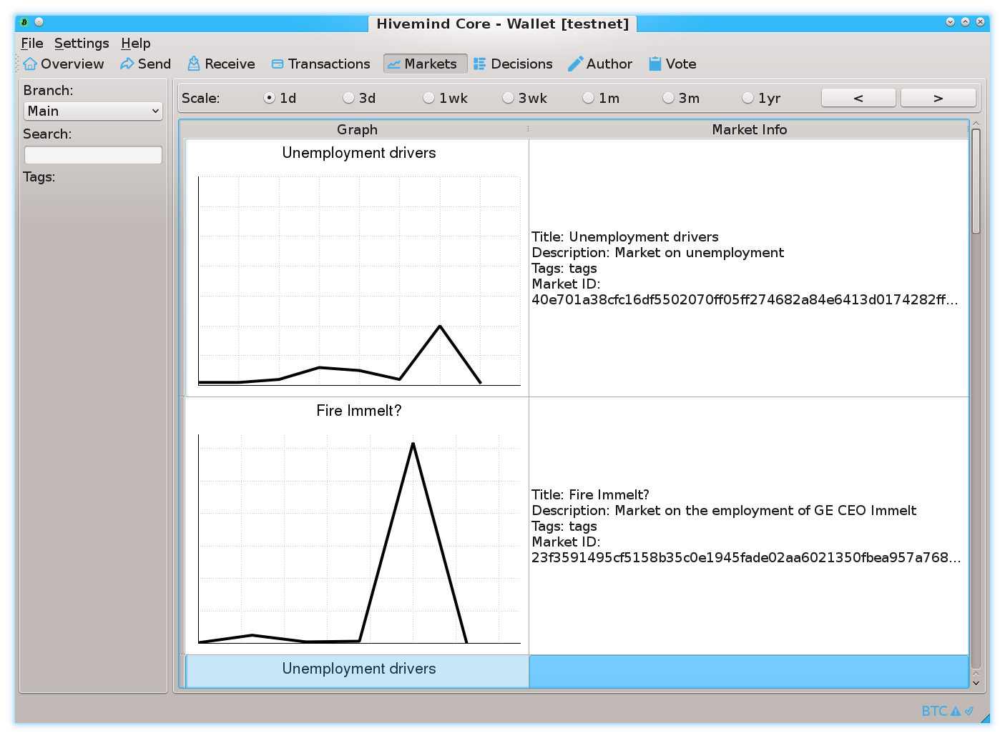
Prediction Markets
Screenshots from my own BTC sidechain project
www.BitcoinHivemind.com
Notes:
…

Slide 33
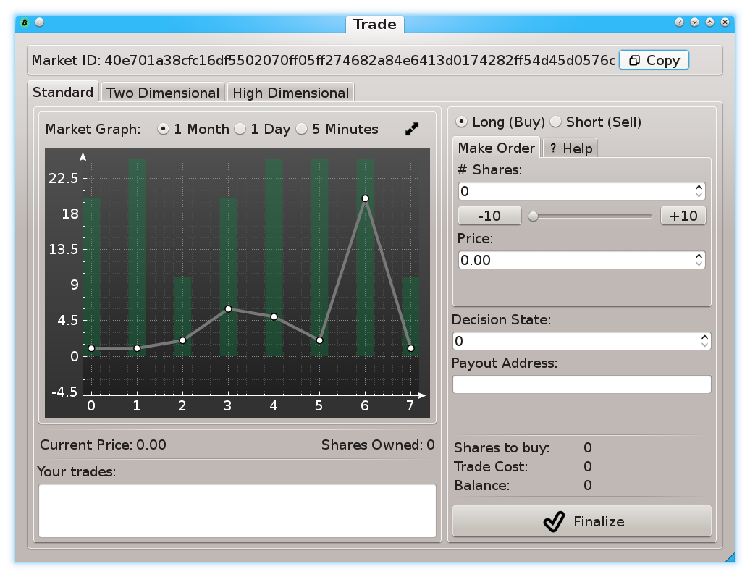
Prediction Markets
Screenshots from my own BTC sidechain project
www.BitcoinHivemind.com
Notes:
… This software can do a lot of things…

Slide 34
Prediction Markets
Screenshots from my own BTC sidechain project
www.BitcoinHivemind.com
Key Idea: “Futarchy” -- futures markets for how well certain leaders would perform, if they were in charge.
Notes:
…but the crowd favorite is ‘Futarchy’ – where there are futures markets for how well certain leaders would perform, if they were in charge. ... This idea is very distressing to bad leaders, [laugh] , because WE can learn about exactly how bad they are going to be, before we cast a vote for anyone. I think that this is one of the most important ideas in the whole world.

Slide 35
Prison Metaphor

Slide 36
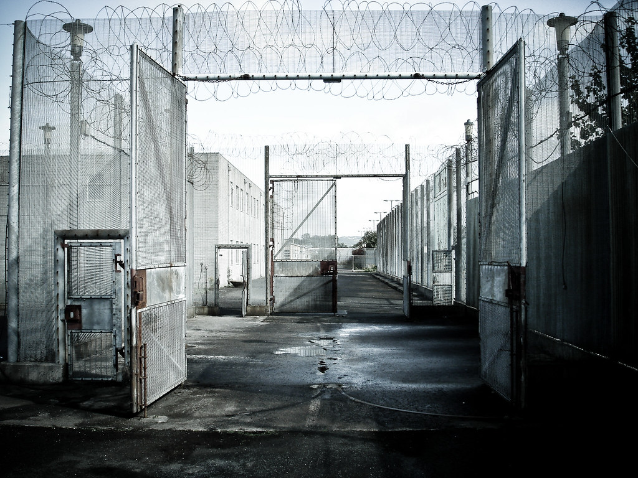


How it Works
New Kind of Output: “Hashrate Escrow”
Anyone can deposit to it at any time.
But withdrawals are very slow.
Series of gates.

Slide 37
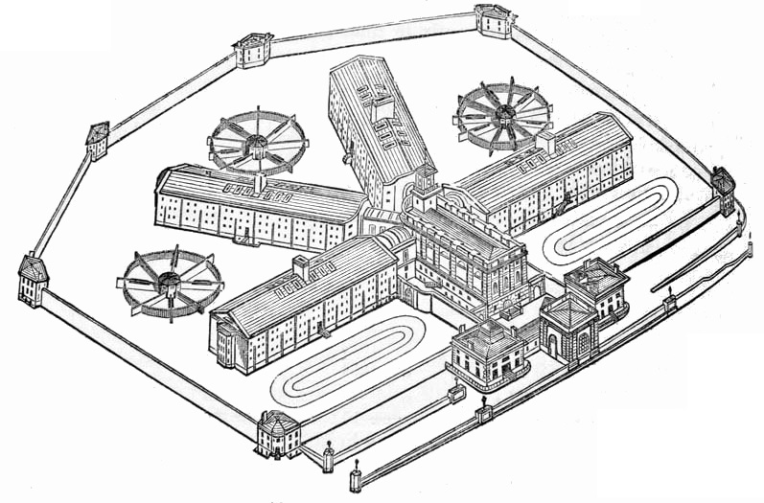

Prison Metaphor
Prison
BTC
…
Only way out.
13,150 Gates

Slide 38
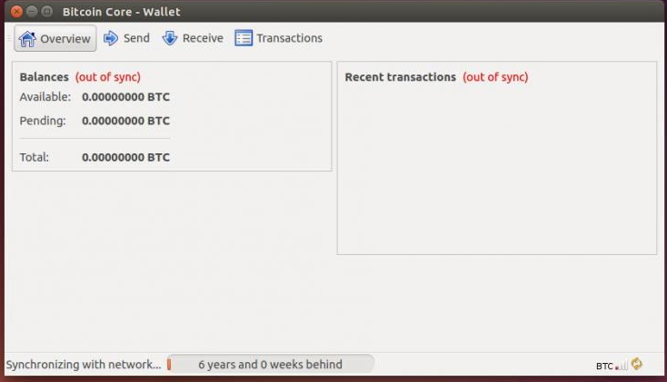
Example
1. Start with Bitcoin Core

Slide 39
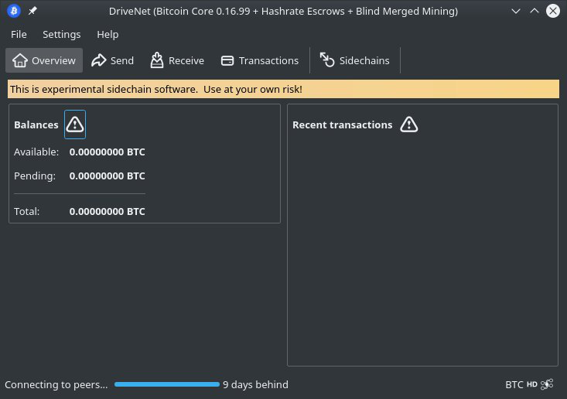
2. Add BIP 300 + 301

Slide 40
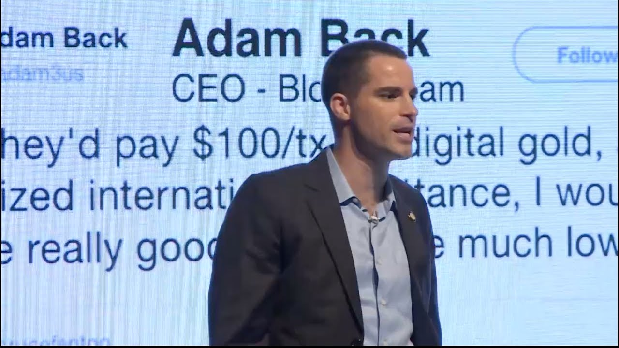
3. Meta-Consensus Problem

Slide 41
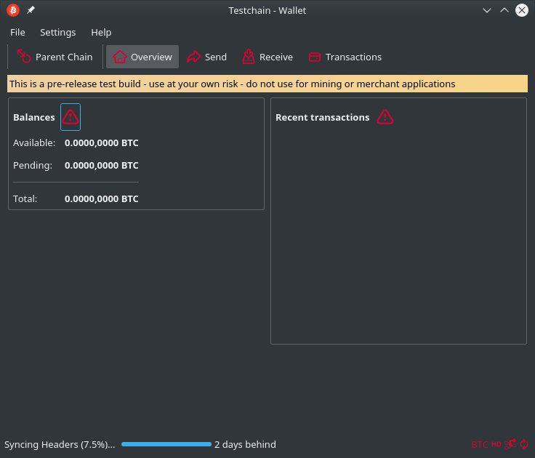
4a. Fork Our Template

Slide 42
Bitcoin Payments
Change Name
Change Blocksize / SIGOP Limits
This software requires a BTC Core Node.
4b. “Bitcoin Payment”

Slide 43
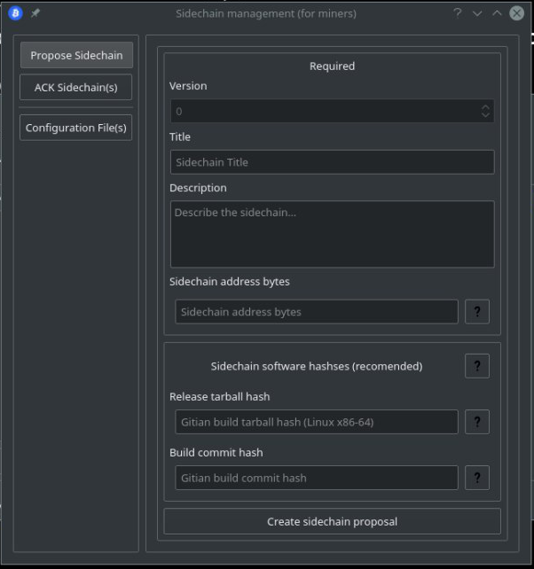
“Bitcoin Payments”
Now Open For Business
5. Add New Escrow

Slide 44
Escrow UTXO
Escrow UTXO
On layer-1:
Roger’s UTXO
Roger’s 50,000 BTC
“Bitcoin Payments”
6a. Spend from Layer-1 to Layer-1.5

Slide 45
Escrow UTXO
Escrow UTXO
Escrow UTXO
On layer-1:
Roger’s UTXO
Brian’s UTXO
Brian’s 7,000 BTC
“Bitcoin Payments”
6b. Spend from Layer-1 to Layer-1.5

Slide 46
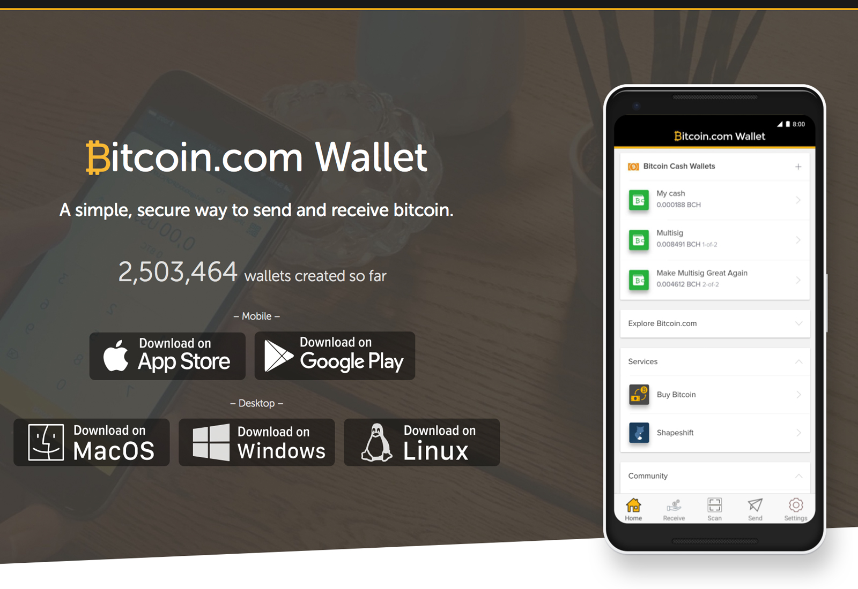
Escrow UTXO
Escrow UTXO
Escrow UTXO
On layer-1:
Roger’s UTXO
Brian’s UTXO
“Bitcoin Payments”
Generates txn fee revenues for miners
7. Spend within the Escrow

Slide 47
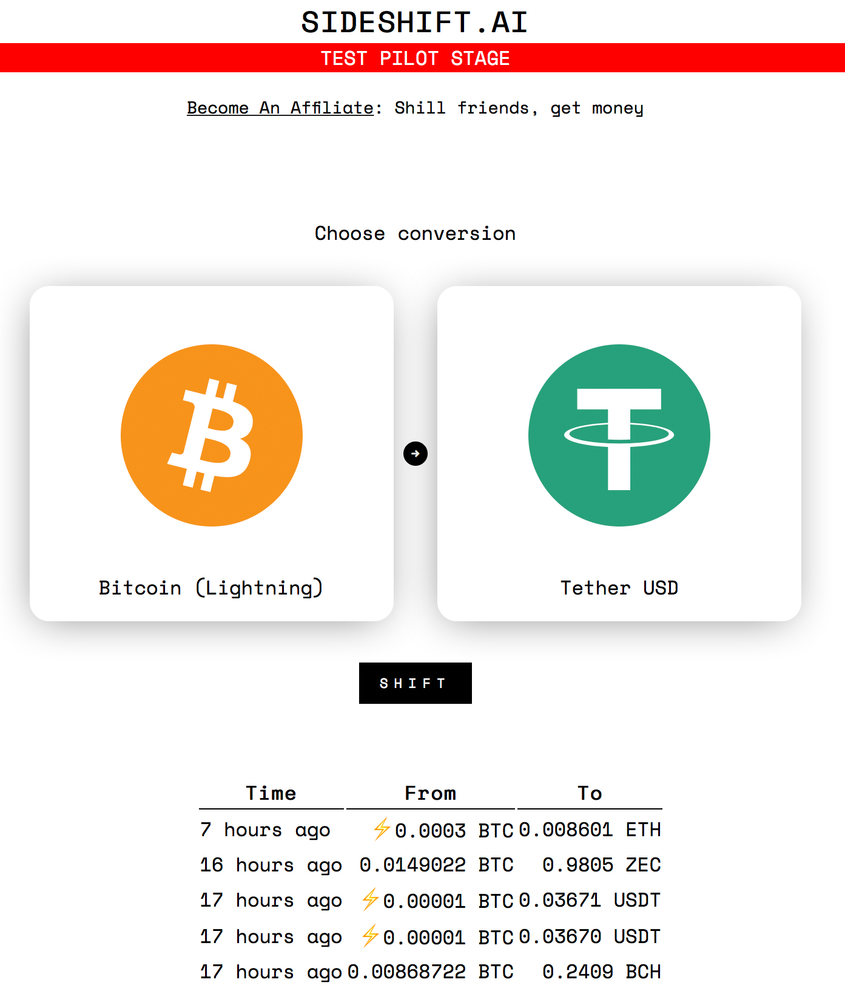
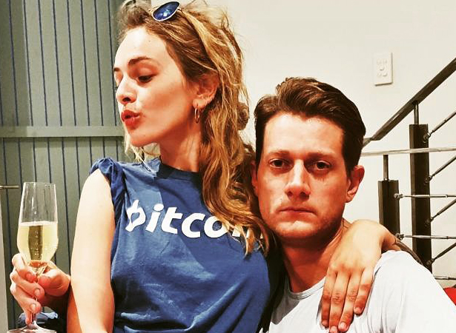
Sideshift, Shapeshift, Atomic Swaps, Etc
Andreas
8a. Swapping to Instant Freedom

Slide 48
Escrow UTXO
Escrow UTXO
Escrow UTXO
On layer-1:
Roger’s UTXO
Brian’s UTXO
Andreas’ UTXO
Jeff’s UTXO
“Bitcoin Payments”
8b. Prisoner Exchange

Slide 49
Escrow UTXO
Escrow UTXO
Escrow UTXO
On layer-1:
Roger’s UTXO
Brian’s UTXO
Andreas’ UTXO
Jeff’s UTXO
Take these 2,980 BTC out please..
Andreas
Roger
Erik
…and these 114.
“Bitcoin Payments”
9. Leaving Prison

Slide 50
Escrow UTXO
Escrow UTXO
Escrow UTXO
Escrow UTXO
Roger’s UTXO
Brian’s UTXO
2980 to Andreas
114 to Erik
Take these 2,980 BTC out please..
32 bytes
…and these 114.
Andreas
What do I need?
Roger
Erik
“Bitcoin Payments”
10. The Withdrawal Txn

Slide 51
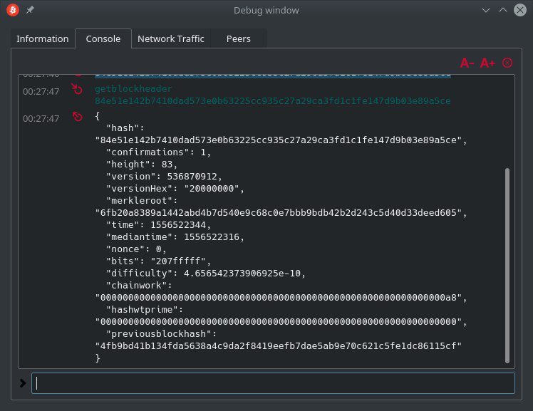
getblockheader
32 bytes
10. The Withdrawal Txn

Slide 52
Prison Metaphor
1st gate
32 bytes
13150th gate
…
11. Starting Off…

Slide 53

Prison Metaphor
32 bytes
Miners
…
12. Making Progress…

Slide 54
Escrow UTXO
Escrow UTXO
On layer-1:
Roger’s UTXO
2980 to Andreas
114 to Erik
Andreas
Erik
…
32 bytes
13. Withdrawal Complete

Slide 55
zCash Example

Slide 56
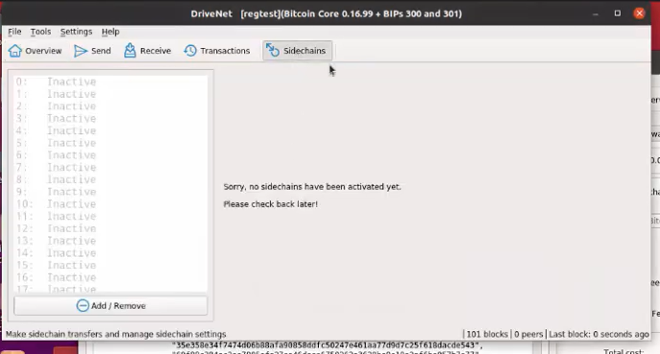
zCash Example
Notes:
Before doing the BIP text, I thought I would just walk you through an example.

Slide 57
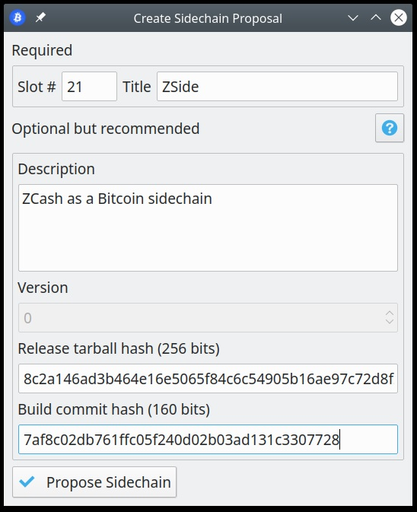
Take a “Slot”
A coinbase message announcing that we want to assign Slot 1:
a global name, and
some optional info to identify the L2 node software

Slide 58
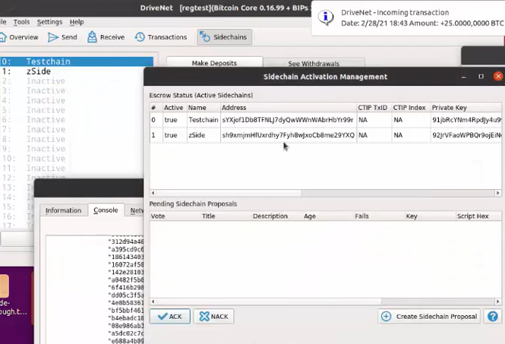
Drivechains are Proposed, and ACKed on L1 Each proposal / Ack is a message in a L1 coinbase txn

Slide 59
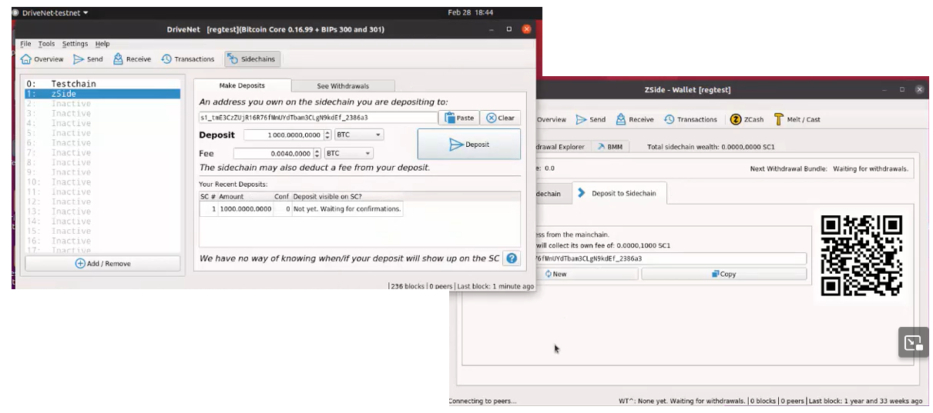
Deposit
1 -- Get destination address from zCash-Drivechain
2 -- Give that to L1
3 -- L1 broadcasts the deposit
4 -- After the deposit confirms on L1, L2 credits user the coins.

Slide 60
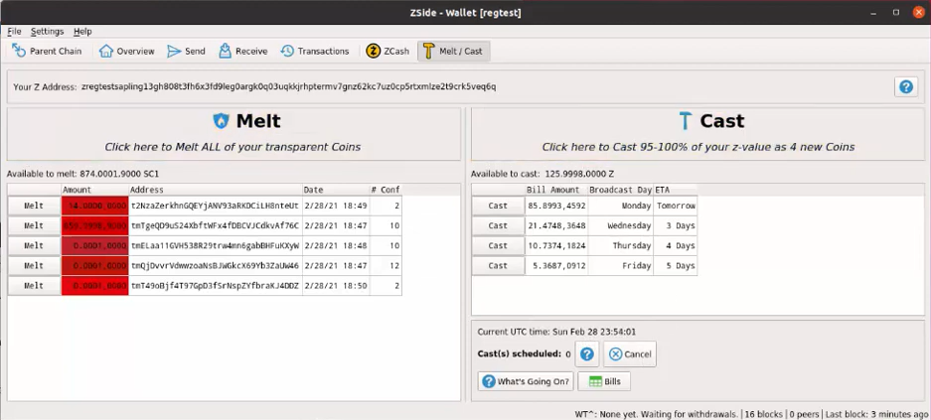
zCash Features
Now we have a z-address to use!

Slide 61
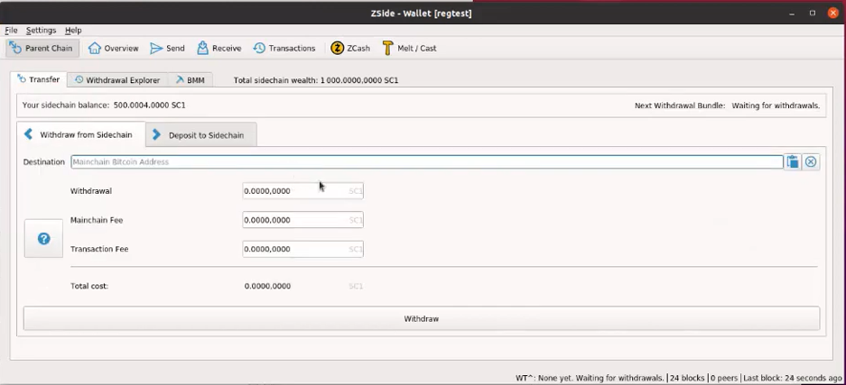
Withdrawing Bit-Zcash to Layer1 BTC

Slide 62
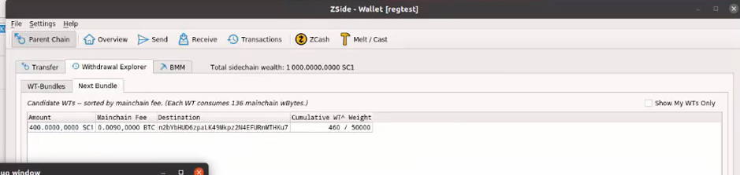

Slide 63
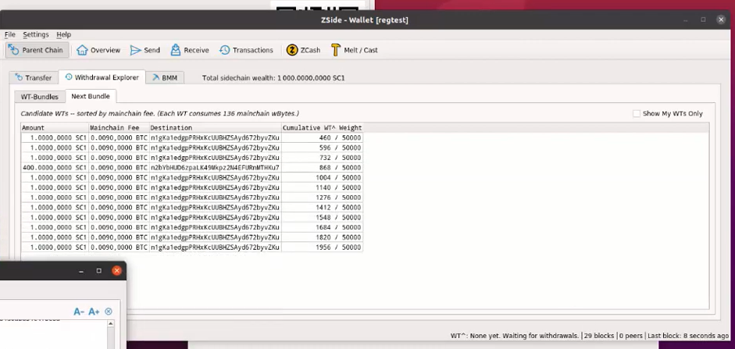

Slide 64
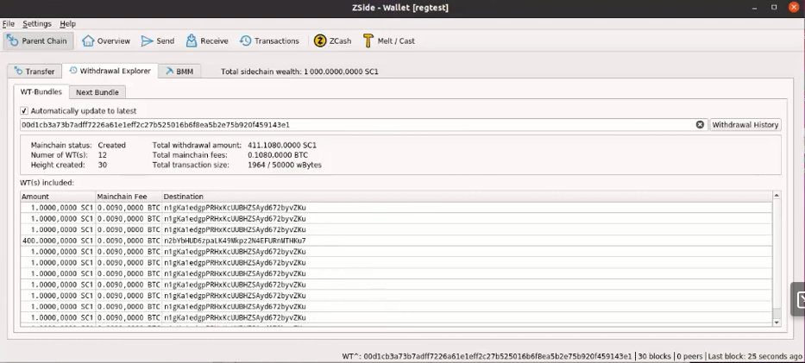

Slide 65
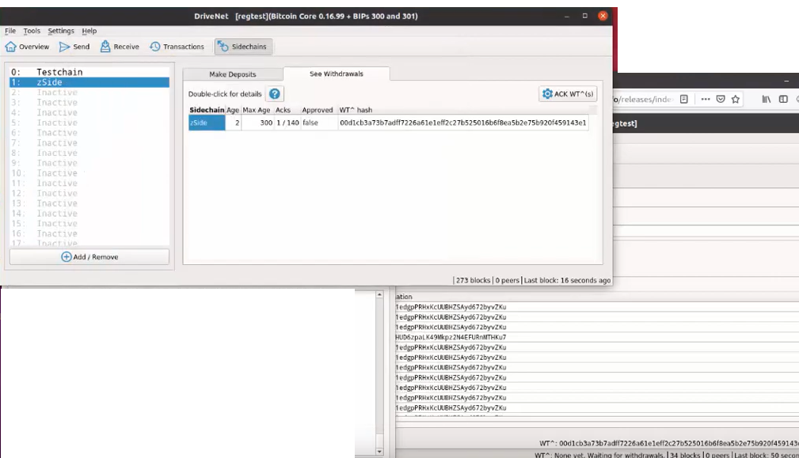

Slide 66
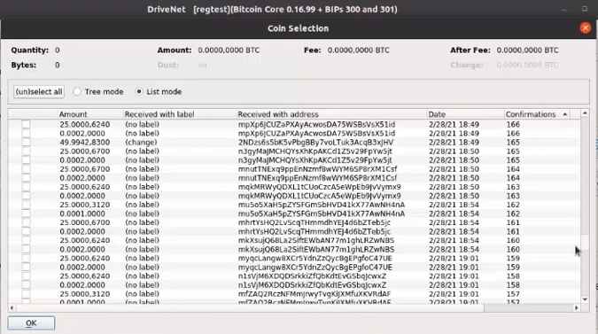

Slide 67
The BIP Text

Slide 68
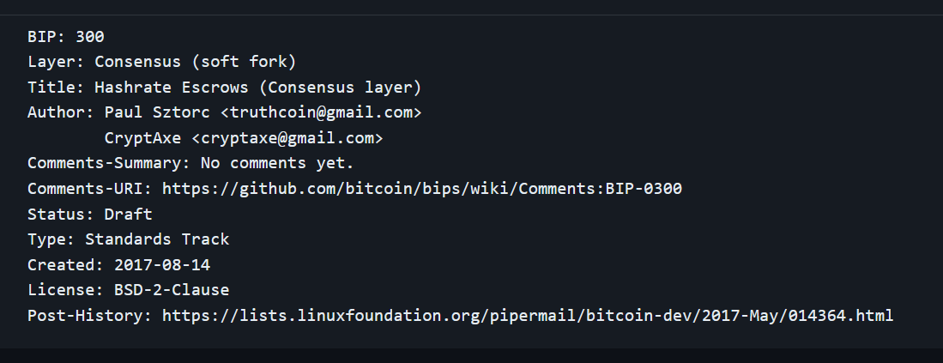
BIP300 – The Six Messages

Slide 69
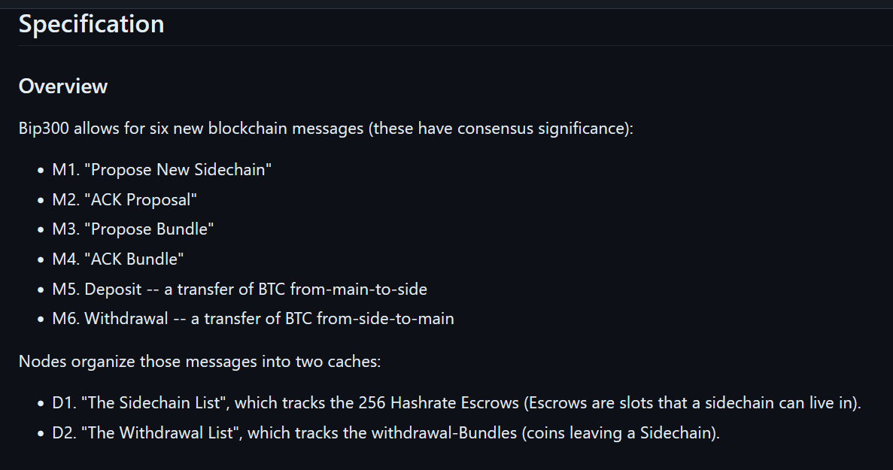

Slide 70
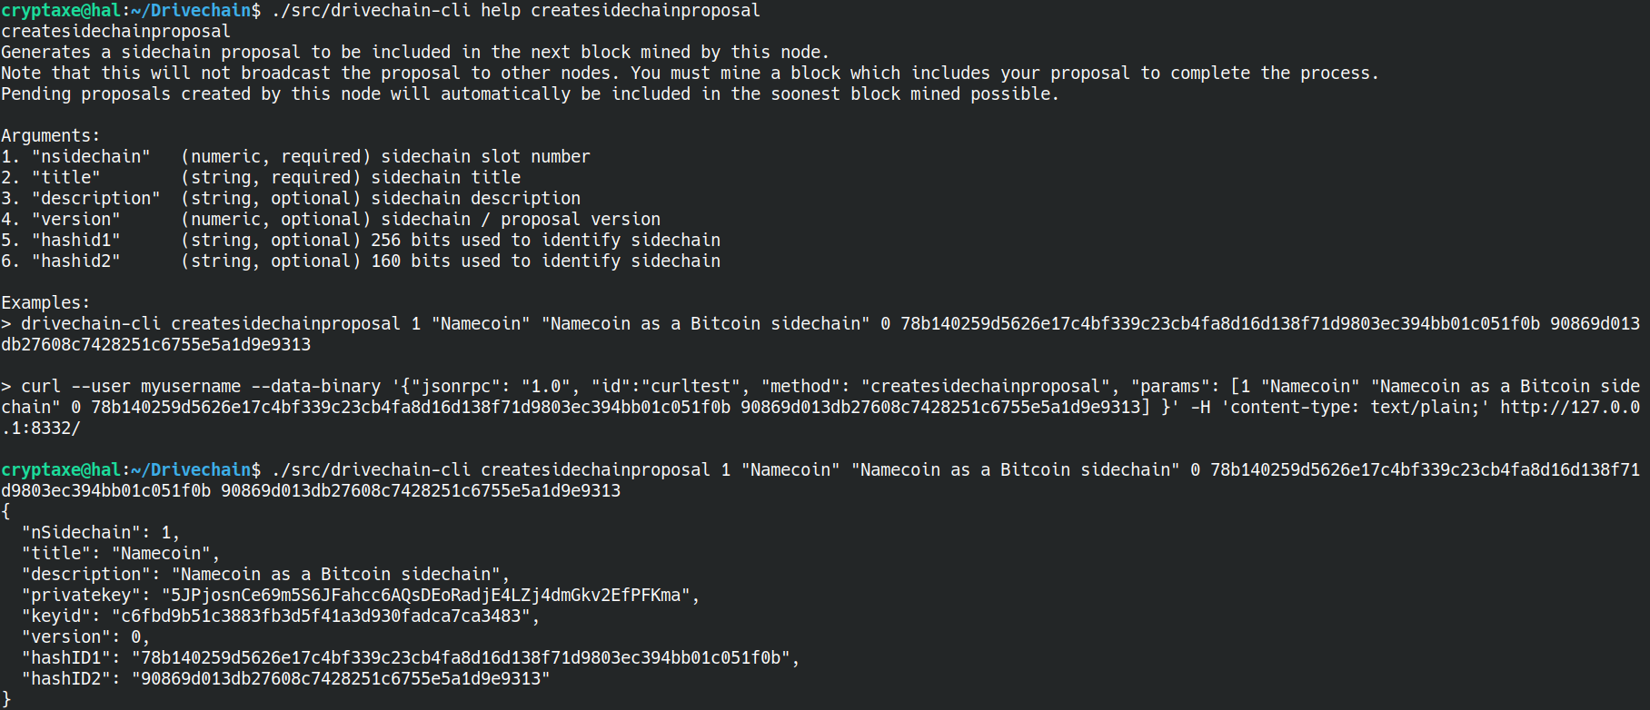
M1

Slide 71
M1
This used to be the private key of the sidechain’s single UTXO....
...we got rid of that, but you can still think of it that way.
This helps people find (and agree on) the sidechain’s full node software.

Slide 72
M1
This used to be the private key of the sidechain’s single UTXO....
1-byte - OP_RETURN (0x6a)
4-byte - Header (0xD5E0C4AF)
N-byte – SC serialization....
1-byte nSidechain
4-byte nVersion
x-byte strKeyID
x-byte strPrivKey
x-byte scriptPubKey
x-byte title
x-byte description
32-byte hashID1
20-byte hashID2
Merkle Tree / \ Coinbase ... Txn 2 Txn 3 ... ... ... Txn 2000 | .
|Output 1 . |Output 2 . |... . |Output n . |... .
...we got rid of that, but you can still think of it that way.
This helps people find (and agree on) the sidechain’s full node software.

Slide 73
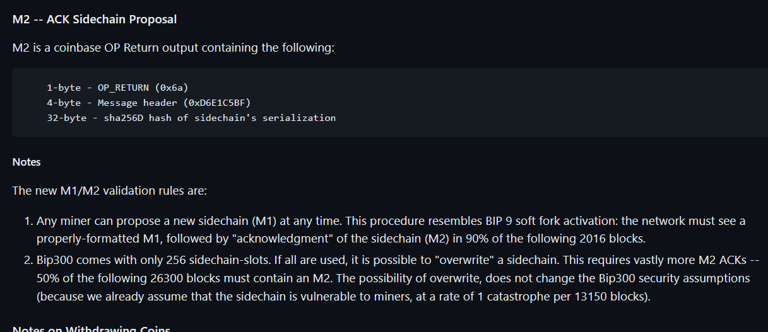
M2

Slide 74
M2
Merkle Tree / \ Coinbase ... Txn 2 Txn 3 ... ... ... Txn 2000 | .
|Output 1 . |Output 2 . |... . |... . |Output n . |... .
0x6AD6E1C5BFE53C1EB00C08BCEBFF2BE1B3E1BDA725279827DC8876C2579705D9F725F8D3B4

Slide 75
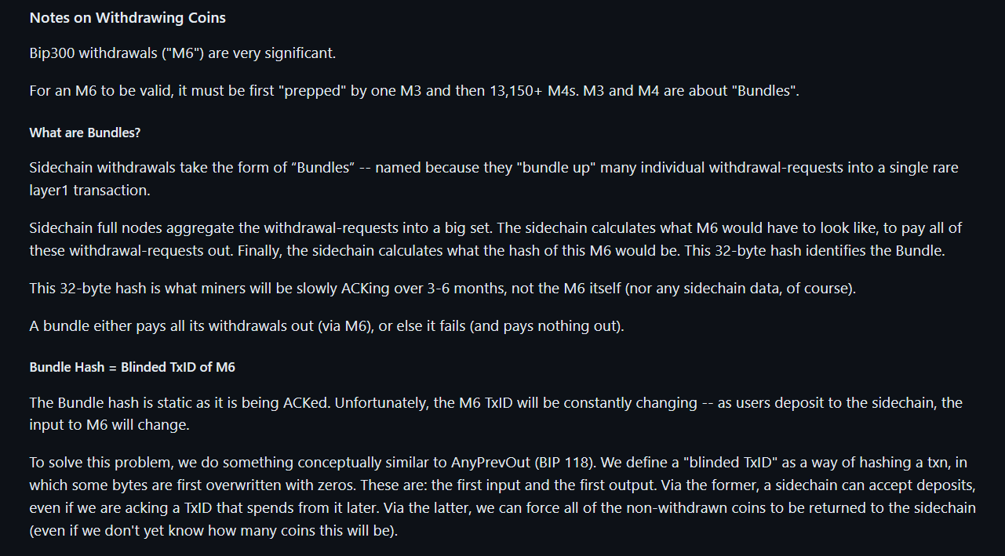
In Drivechain, “Bundles” are very important!

Slide 76
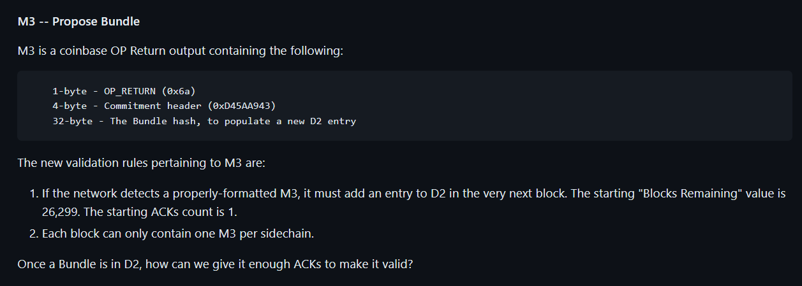
M3
Merkle Tree / \ Coinbase ... Txn 2 Txn 3 ... ... ... Txn 2000 | .
|Output 1 . |Output 2 . |... . |... . |... . |Output n . |... .
0x6AD45AA9435DE475C54F292D357B4665C4A06673354D0AF583ABEC2AC51B752FDF06FCDBBD

Slide 77
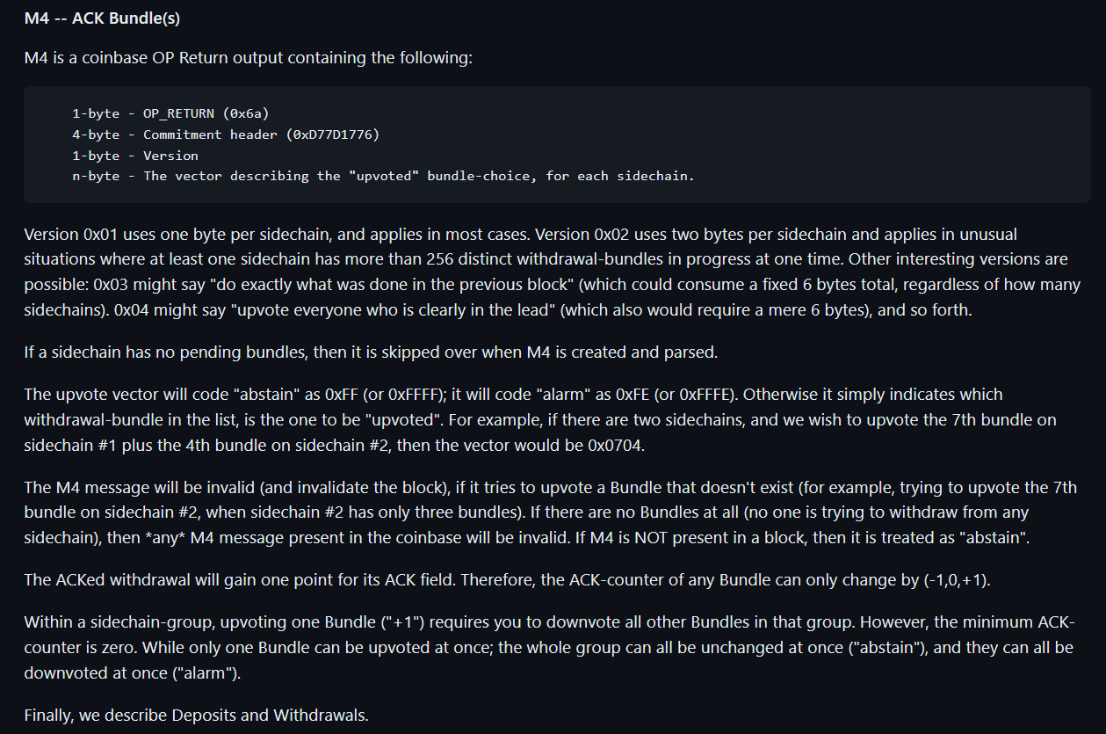
M4

Slide 78
M4
Merkle Tree / \ Coinbase ... Txn 2 Txn 3 ... ... ... Txn 2000 | .
|Output 1 . |Output 2 . |... . |... . |... . |... . |Output n . |... .
0x6AD77D17760001000003000001

Slide 79
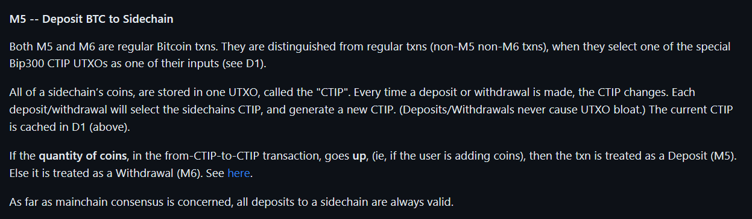
M5 – Depositing Coins
Escrow UTXO
Escrow UTXO
Escrow UTXO
Roger’s UTXO
Brian’s UTXO
Coin Quantity Increasing = Deposit

Slide 80
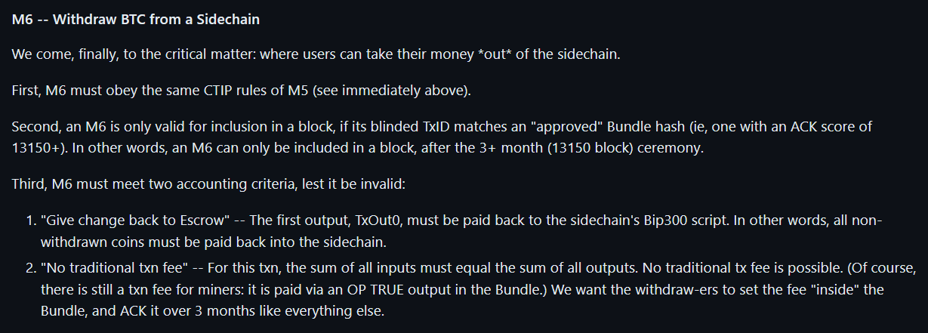
M6
Escrow UTXO
Escrow UTXO
Coin Quantity Decreasing = Withdrawal
2980 to Andreas
114 to Erik
Only one M6 every three months, max [ per sidechiain ].
b_TxID ( M6 ) broadcasted first, the actual M6 only comes later.
M6 is never in the Mempool.

Slide 81
Theory – Policing a [Chain] We Can’t See

Slide 82
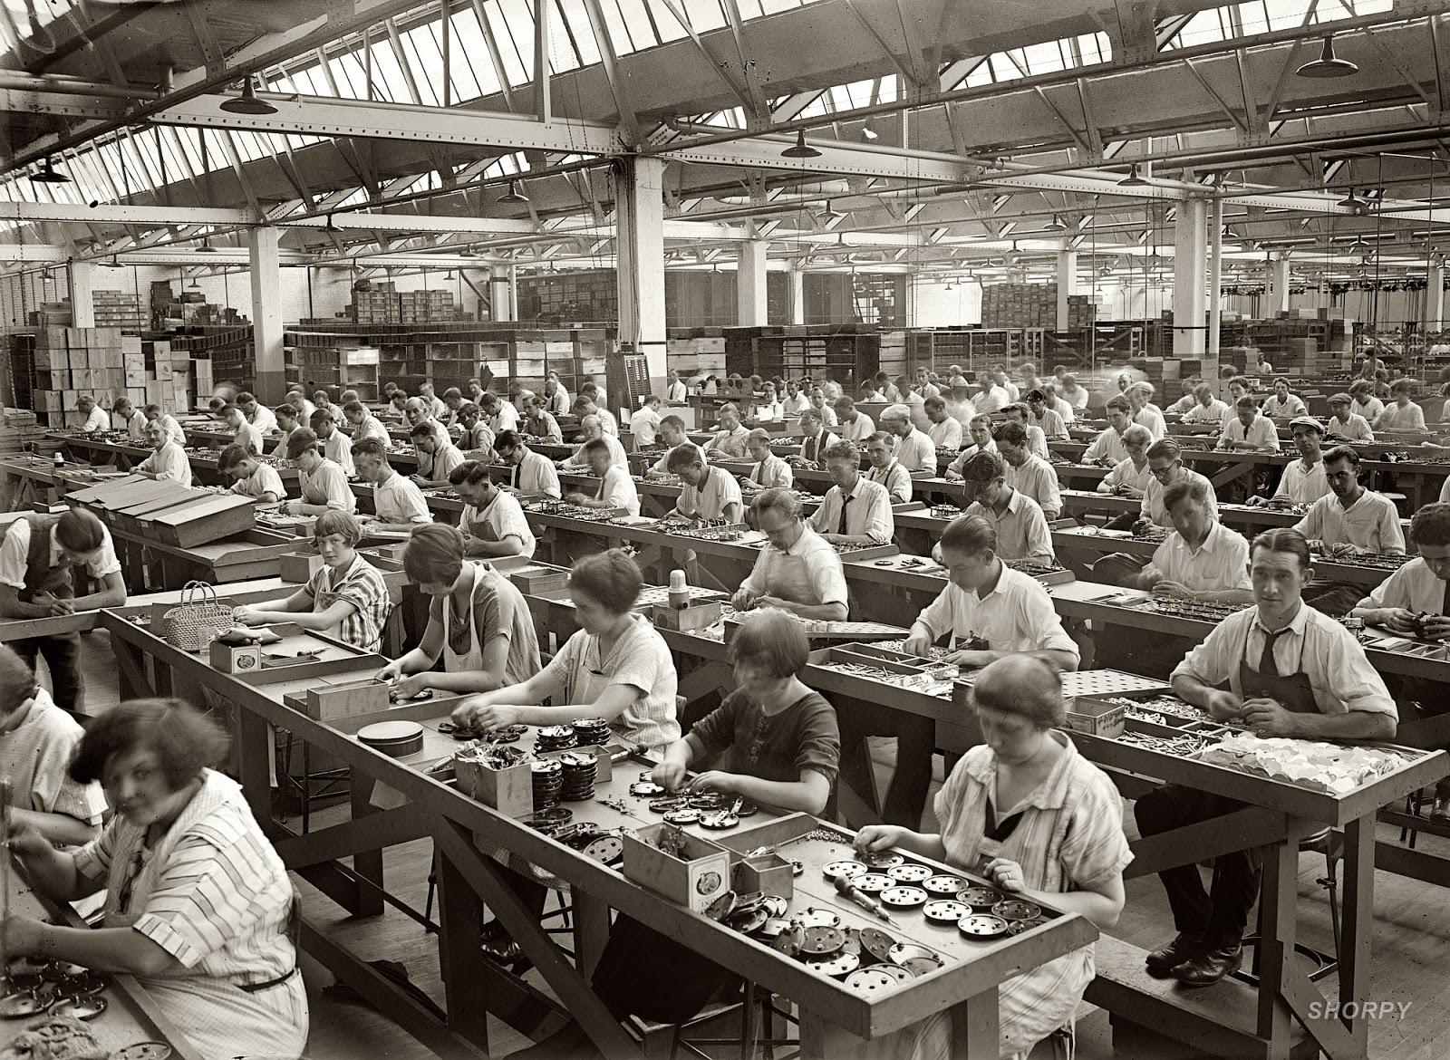

Miners
Optimizing: kWh /$ / ASIC Efficiency / Cooling / Labor / Demand Management Programs / Drying Fruit / Getting NatGas Credits / Outcompeting All Rivals
Full Node
Validating L1
+ counting to 13,150
+ add/remove/validate Sidechains

Slide 83
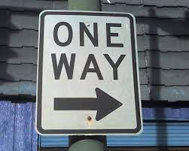
The “One Way Street”
Bip300 Drivechains
Layer 2
Bit-zCash
Bit-Monero
L2 node must have access to an L1 node
Drama
Centralization
Reorgs
Bad Design
Layer 1
Bitcoin Core
Notes:
Ok, aspect two – the base layer ( ie, Bitcoin Core, ie the mainchain, ie “layer1”) that – your Bitcoin node -- is unaffected by problems on the sidechain. Even under very extreme adversarial conditions where the sidechain experiencing all sorts of chaos, Layer1 is just going to solider on, and ignore all of that. The drama can only go one way. So, let me try to explain this.

Slide 84
The “One Way Street”
Bip300 Drivechains
Bit-zCash
Bit-Monero
Layer 2
Drama?
“I’m having a problem with my ring signatur---”
Drama
Centralization
Reorgs
Bad Design
Layer 1
Bitcoin Core
Notes:
Ok, aspect two – the base layer ( ie, Bitcoin Core, ie the mainchain, ie “layer1”) that – your Bitcoin node -- is unaffected by problems on the sidechain. Even under very extreme adversarial conditions where the sidechain experiencing all sorts of chaos, Layer1 is just going to solider on, and ignore all of that. The drama can only go one way. So, let me try to explain this.

Slide 85

The “One Way Street”
Bip300 Drivechains
Bit-zCash
Bit-Monero
Layer 2
Drama?
“I’m having a problem with my ring signatur---”
Drama
Centralization
Reorgs
Bad Design
Layer 1
Can’t hear you, sorry.
Bitcoin Core
Notes:
Ok, aspect two – the base layer ( ie, Bitcoin Core, ie the mainchain, ie “layer1”) that – your Bitcoin node -- is unaffected by problems on the sidechain. Even under very extreme adversarial conditions where the sidechain experiencing all sorts of chaos, Layer1 is just going to solider on, and ignore all of that. The drama can only go one way. So, let me try to explain this.

Slide 86
The “One Way Street”
Bip300 Drivechains
Bit-zCash
Bit-Monero
Layer 2
Drama?
Drama
Centralization
Reorgs
Bad Design
What’s that?? Oh Sorry can’t hear you. Enjoying my music over here.
Layer 1
Bitcoin Core
Notes:
Ok, aspect two – the base layer ( ie, Bitcoin Core, ie the mainchain, ie “layer1”) that – your Bitcoin node -- is unaffected by problems on the sidechain. Even under very extreme adversarial conditions where the sidechain experiencing all sorts of chaos, Layer1 is just going to solider on, and ignore all of that. The drama can only go one way. So, let me try to explain this.

Slide 87
Putting Hash(L2) into L1
= Block Header
= List of transactions
December 2020
January 2021
February 2021
March 2021
April 2021
Base Layer (Bitcoin Core)
Notes:
Here is a representation of Bitcoin’s blockchain. The squares are block headers, and the trailing rectangles are the list of transactions in each block. (Because blocks aren’t always the same size, of course.) And time is flowing from left to right. You can see across the top I’m going from Dec to April. Normally, of course, there would be tens of thousands of blocks (from Dec to April), that wouldn’t have FIT on the slides so there’s only seventeen. Now, what if there was a sidechain, activated, this whole time? Like a clone of Monero, or something. Well, we’ll put it up...

Slide 88
Putting Hash(L2) into L1
= Block Header
= List of transactions
December 2020
January 2021
February 2021
March 2021
April 2021
Layer 2 (Bit-Monero)
Base Layer (Bitcoin Core)
Notes:
Here it is. It has its own blocks, and its own block headers, and its own block chain, from December (on the left) to April (on the right). Now, the idea is ... that ...

Slide 89
Putting Hash(L2) into L1
= Block Header
= List of transactions
December 2020
January 2021
February 2021
March 2021
April 2021
Layer 2 (Bit-Monero)
e320
81cd
3 Months = One 32-byte Hash
3 Months = One 32-byte Hash
e320b6c2fffc8d750423db8b1eb942ae710e951ed797f7affc8892b0f1fc122b
81cd02ab7e569e8bcd9317e2fe99f2de44d49ab2b8851ba4a308000000000000
Base Layer (Bitcoin Core)
e320 ... Pays Out
Notes:
... Three months of sidechain activity are compressed into one little 64-character string here. And that string is the only thing inserted into Layer1. Ever. So, no matter what Bit-Monero over here is doing, this is all that layer1 will see.. ready ?

Slide 90
Your Layer 1 Node Sees…
Putting Hash(L2) into L1
Base Layer (Bitcoin Core)
e320b6c2fffc8d750423db8b1eb942ae710e951ed797f7affc8892b0f1fc122b
e320 ... Pays Out
81cd02ab7e569e8bcd9317e2fe99f2de44d49ab2b8851ba4a308000000000000
Notes:
This. Therefore, full nodes (on Layer1, down here in blue); they do not check anything that is happening on the sidechain (where there can be, theoretically, unlimited complexity). The sidechain doesn’t need to be a blockchain, it doesn’t need to be written in c++, it can make all kinds of mistakes. Etc. Bip300 operates entirely off of this one little string (here in green). (!) It does a lot of logic to that 4 little string, and assumptions and engineering, game theory economics, etc. I don’t have time to explain all of it. But the point is that Layer1 can’t be harmed by Layer2 because it really is ignoring Layer2. I feel compelled to drive this point even further, so...

Slide 91
But then how is it secure??

Slide 92
Miners
Optimizing: kWh /$ / ASIC Efficiency / Cooling / Labor / Demand Management Programs / Drying Fruit / Getting NatGas Credits / Outcompeting All Rivals
Full Node
Validating L1
+ counting to 13,150
+ add/remove/validate Sidechains

Slide 93
Prison Metaphor
Prison
BTC
…
Only way out.
13,150 Gates

Slide 94


Summary
Txn Fees
Token Value
Miners
e
New source of miner-profits.
Miners choice: claim this revenue, or destroy it.
High-Auditability:
Reducing “all txns” down to “net transfers”.
Crunching all xfers down to 32 bytes.
One transfer at a time.
Transfers take 3 months to settle.
Notes:
Earn money from running the prison.

Slide 95
Miners can already:
Steal from LN channels – by censoring the justice txn
Reorg mainchain Bitcoin txns out, and hold them hostage
Block any message from L1 – including zk-proofs
So, marginally, it is not actually very large an assumption.

Slide 96
Two Critiques

Slide 97
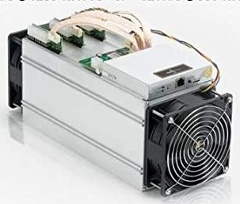
Two Supposed Drawbacks
(#1) Miners-Can-Steal from Bip300 Scripts (and this is bad)
Hashrate
fixed
cost
0%
100%
(#2) Merged-Mining is a Side-Hustle (and those are bad)
eb942ae710e951ed797e320b6c2fffc8d750423db8b1f2b0f1fc122b7affc889
eb94 ... Pays Out
e320b6c2fffc8d750423db8b1eb942ae710e951ed797f7affc8892b0f1fc122b
Notes:
… Ok now for those *drawbacks*. Here they are. The first supposed drawback of Bip300, is that miners can ---with a little bit of setup and technical knowledge and effort on their part, and certainly patience--- miners can remove all the coins from a Bip300 sidechain, and pay those coins, to themselves. Hence it is called the “miners- can-steal” problem. Here you see an evil miner, replacing that one hash I mentioned before with a different hash, and then it eventually pays out (to the miner). The second, supposed drawback of Bip300, *sigh* is: if some miners ever have a profitable side- hustle, then maybe some other miners might not be able to have that side hustle. And then they might go out of business; and wouldn’t be able to buy as many Xmas presents for their children.

Slide 98
(#1) Miners-Can-Steal from Bip300 Scripts (and this is bad) | (#2) Merged-Mining is a Side-Hustle (and those are always bad)
The free market allows entrepreneurs to go bankrupt – this is an essential part of creativity. True: not every SC will succeed. But those few that do, will pay fees to miners and boost BTC’s appeal (since BTC can now easily do everything). The failures will serve as a warning to lazy or incompetent developers. | The fixed cost in question… …is zero under BMM. …was already microscopic, vs other miner fixed costs. …must always be small enough for non-mining nodes to exist (since their revenue is the smallest of all, $0.)
Bip300 has multiple safeguards in place to make “stealing” difficult. Stealing requires 3-6 months of openly dishonest mining activity. Humans can audit theft, by checking just 32 bytes. | Mining is a complex task involving many “sub-tasks” (getting cheap power / sourcing good ASICs / etc). Each has its own incentives, innovation, and fixed costs. No stopping those.
Miners “can” steal from Lightning Network (by broadcasting old state + censoring Justice Txns), but this criterion is never held against LN. | Bizarre implications: if BitFury sold t-shirts on the side, for profit, then t-shirts = bad for BTC. If Saylor altruistically paid miners $0.10 per year, then MS = bad for Bitcoin.
The user is sovereign. Users are allowed to sell their BTC for USD; or use BTC to buy “bad” products (ie “drugs”). Or invest in Alts / scams. Bip300 allows users to spend BTC to a script. | MM is the opposite of bad – it is good and necessary. MM alone can boost BTC’s fee revenues by 10,000x or more. Without MM, long run hashrate may be too low.
This supposed “flaw” is actually a pro, as it gives miners motive and opportunity to destroy “parasite sidechains” (SC which antagonize other SCs). I am not aware of any other way of efficiently accomplishing this. And I believe it is prerequisite for high-quality smart contracts. | What is probably happening is that people are confusing node costs with mining costs. Node costs *must* be low, for decentralization. But mining costs have no such requirement. In fact, if we wanted mining costs to be low we could remove the upward difficulty adjustments.
The whole point of SCs is that Layer1 nodes ignore them. With federations, you trust a fixed committee of law-abiding people. With BIp300 you trust a decentralized P2P process. | MM is already unblockable. Satoshi invented MM in 2010, and envisioned many independent MM chains. We have been MM since 2011, with no end in sight.
Notes:
Both of these are so, false, that its hard to know where to begin.

Slide 99
(#1) Miners-Can-Steal from Bip300 Scripts (and this is bad) | (#2) Merged-Mining is a Side-Hustle (and those are always bad)
The free market allows entrepreneurs to go bankrupt – this is an essential part of creativity. True: not every SC will succeed. But those few that do, will pay fees to miners and boost BTC’s appeal (since BTC can now easily do everything). The failures will serve as a warning to lazy or incompetent developers. | The fixed cost in question… …is zero under BMM. …was already microscopic, vs other miner fixed costs. …must always be small enough for non-mining nodes to exist (since their revenue is the smallest of all, $0.)
Bip300 has multiple safeguards in place to make “stealing” difficult. Stealing requires 3-6 months of openly dishonest mining activity. Humans can audit theft, by checking just 32 bytes. | Mining is a complex task involving many “sub-tasks” (getting cheap power / sourcing good ASICs / etc). Each has its own incentives, innovation, and fixed costs. No stopping those.
Miners “can” steal from Lightning Network (by broadcasting old state + censoring Justice Txns), but this criterion is never held against LN. | Bizarre implications: if BitFury sold t-shirts on the side, for profit, then t-shirts = bad for BTC. If Saylor altruistically paid miners $0.10 per year, then MS = bad for Bitcoin.
The user is sovereign. Users are allowed to sell their BTC for USD; or use BTC to buy “bad” products (ie “drugs”). Or invest in Alts / scams. Bip300 allows users to spend BTC to a script. | MM is the opposite of bad – it is good and necessary. MM alone can boost BTC’s fee revenues by 10,000x or more. Without MM, long run hashrate may be too low.
This supposed “flaw” is actually a pro, as it gives miners motive and opportunity to destroy “parasite sidechains” (SC which antagonize other SCs). I am not aware of any other way of efficiently accomplishing this. And I believe it is prerequisite for high-quality smart contracts. | What is probably happening is that people are confusing node costs with mining costs. Node costs *must* be low, for decentralization. But mining costs have no such requirement. In fact, if we wanted mining costs to be low we could remove the upward difficulty adjustments.
The whole point of SCs is that Layer1 nodes ignore them. With federations, you trust a fixed committee of law-abiding people. With BIp300 you trust a decentralized P2P process. | MM is already unblockable. Satoshi invented MM in 2010, and envisioned many independent MM chains. We have been MM since 2011, with no end in sight.
c
Notes:
So, Bip300 is designed, to prevent miners from stealing from sidechains. But, it is nonetheless possible. Similarly, – miners “can” (can in quotes **) steal from the LN. In fact its much easier for miners to steal from the LN, since Bip300 has this 6 month timeout period. So, were you worried about miners stealing from the lightning network a moment ago? If so, just cross off this entire left half of the page. I have to stress: this comparison isn’t to knock the LN, I’m saying that the criterion is stupid. 51% hashrate can do a lot of horrible things, but that doesn’t stop us from allowing users to opt-in to certain tradeoffs. After all, its Bitcoin not Prison.

Slide 100
(#1) Miners-Can-Steal from Bip300 Scripts (and this is bad) | (#2) Merged-Mining is a Side-Hustle (and those are always bad)
The free market allows entrepreneurs to go bankrupt – this is an essential part of creativity. True: not every SC will succeed. But those few that do, will pay fees to miners and boost BTC’s appeal (since BTC can now easily do everything). The failures will serve as a warning to lazy or incompetent developers. | The fixed cost in question… …is zero under BMM. …was already microscopic, vs other miner fixed costs. …must always be small enough for non-mining nodes to exist (since their revenue is the smallest of all, $0.)
Bip300 has multiple safeguards in place to make “stealing” difficult. Stealing requires 3-6 months of openly dishonest mining activity. Humans can audit theft, by checking just 32 bytes. | Mining is a complex task involving many “sub-tasks” (getting cheap power / sourcing good ASICs / etc). Each has its own incentives, innovation, and fixed costs. No stopping those.
Miners “can” steal from Lightning Network (by broadcasting old state + censoring Justice Txns), but this criterion is never held against LN. | Bizarre implications: if BitFury sold t-shirts on the side, for profit, then t-shirts = bad for BTC. If Saylor altruistically paid miners $0.10 per year, then MS = bad for Bitcoin.
The user is sovereign. Users are allowed to sell their BTC for USD; or use BTC to buy “bad” products (ie “drugs”). Or invest in Alts / scams. Bip300 allows users to spend BTC to a script. | MM is the opposite of bad – it is good and necessary. MM alone can boost BTC’s fee revenues by 10,000x or more. Without MM, long run hashrate may be too low.
This supposed “flaw” is actually a pro, as it gives miners motive and opportunity to destroy “parasite sidechains” (SC which antagonize other SCs). I am not aware of any other way of efficiently accomplishing this. And I believe it is prerequisite for high-quality smart contracts. | What is probably happening is that people are confusing node costs with mining costs. Node costs *must* be low, for decentralization. But mining costs have no such requirement. In fact, if we wanted mining costs to be low we could remove the upward difficulty adjustments.
The whole point of SCs is that Layer1 nodes ignore them. With federations, you trust a fixed committee of law-abiding people. With BIp300 you trust a decentralized P2P process. | MM is already unblockable. Satoshi invented MM in 2010, and envisioned many independent MM chains. We have been MM since 2011, with no end in sight.
Notes:
The second one is even sillier. I think what I would like to highlight is that the implications are ridiculous. So, if BitFury sold t-shirts on the side, for profit, then t-shirts = bad for BTC. They would be as bad for Bitcoin as Bip300 is, anyway. If Michal Saylor altruistically paid miners $0.10 per year, then MS = bad for 9 Bitcoin. Blah blah blah... I think what’s really happening here, is that people are confusing nodes with miners. Miners run nodes, but not the other way around. We want nodes to be as cheap as possible. That is absolutely important; but we don’t want mining to be as cheap as possible. If we wanted that, we could just get rid of all of the upward difficulty adjustments. So I have total contempt for these two supposed drawbacks. In fact both of them are not drawbacks at all…

Slide 101
(#1) Miners-Can-Steal from Bip300 Scripts (and this is bad) | (#2) Merged-Mining is a Side-Hustle (and those are always bad)
The free market allows entrepreneurs to go bankrupt – this is an essential part of creativity. True: not every SC will succeed. But those few that do, will pay fees to miners and boost BTC’s appeal (since BTC can now easily do everything). The failures will serve as a warning to lazy or incompetent developers. | The fixed cost in question… …is zero under BMM. …was already microscopic, vs other miner fixed costs. …must always be small enough for non-mining nodes to exist (since their revenue is the smallest of all, $0.)
Bip300 has multiple safeguards in place to make “stealing” difficult. Stealing requires 3-6 months of openly dishonest mining activity. Humans can audit theft, by checking just 32 bytes. | Mining is a complex task involving many “sub-tasks” (getting cheap power / sourcing good ASICs / etc). Each has its own incentives, innovation, and fixed costs. No stopping those.
Miners “can” steal from Lightning Network (by broadcasting old state + censoring Justice Txns), but this criterion is never held against LN. | Bizarre implications: if BitFury sold t-shirts on the side, for profit, then t-shirts = bad for BTC. If Saylor altruistically paid miners $0.10 per year, then MS = bad for Bitcoin.
The user is sovereign. Users are allowed to sell their BTC for USD; or use BTC to buy “bad” products (ie “drugs”). Or invest in Alts / scams. Bip300 allows users to spend BTC to a script. | MM is the opposite of bad – it is good and necessary. MM alone can boost BTC’s fee revenues by 10,000x or more. Without MM, long run hashrate may be too low.
This supposed “flaw” is actually a pro, as it gives miners motive and opportunity to destroy “parasite sidechains” (SC which antagonize other SCs). I am not aware of any other way of efficiently accomplishing this. And I believe it is prerequisite for high-quality smart contracts. | What is probably happening is that people are confusing node costs with mining costs. Node costs *must* be low, for decentralization. But mining costs have no such requirement. In fact, if we wanted mining costs to be low we could remove the upward difficulty adjustments.
The whole point of SCs is that Layer1 nodes ignore them. With federations, you trust a fixed committee of law-abiding people. With BIp300 you trust a decentralized P2P process. | MM is already unblockable. Satoshi invented MM in 2010, and envisioned many independent MM chains. We have been MM since 2011, with no end in sight.
Notes:
… the left one allows for super-reliable oracle and high-quality smart contracts, and the right one is the only thing that is going to keep hashrate security up, in the future. So, they’re not drawbacks at all, in fact they’re both pretty cool; features.

Slide 102
Thank You for Your Attention! Questions?
Notes:
Ok that’s the talk, thank you! : )

Slide 103

What does affect mainchain miners: Altcoins

Slide 104
What does affect mainchain miners: Altcoins
Price
(sat/byte)
R1
Quantity
(bytes)
R1 > R2

Slide 105



High Fees → Less Usage Last 2 Years, Log Scales, 7d average

Slide 106
Fee revenues are important…

Slide 107
…and supply affects Fee Revenues.
Price
(sat/byte)
R1
Quantity
(bytes)
R1 > R2

Slide 108
What does affect mainchain miners: Altcoins
Price
(sat/byte)
Quantity
(bytes)
R1 < R2
( See my blog post: “Two types of Blockspace Demand” for more. )

Slide 109




(#3) Improve Mining Incentives (Bip 301)
Get all of the fees, on all of the chains!
Miners can ignore Sidechain / Altcoin software.
Taken from https://cryptofees.info/ this morning.
June 4, 2021
Notes:
Okay third aspect. This one is only this one slide here. Third aspect is that we want to improve Mining Incentives (Bip301). This is technically Bip301, now. I separated the two BIPs, to make them easier to read. But I think anyone with a brain who uses Bip300, would use Bip301 also – but you don’t have to. Anyway, with Blind Merged Mining (BIP 301), miners don’t need to pay attention to Sidechains, at all. So, layer1 users already weren’t paying attention, now layer1 miners can also ignore Sidechains (if they want). They still collect all of the transaction fee-revenues from the sidechain’s txn! How? Well, they contract with someone else who is running a sidechain full node, and the miner sells them the block- rights, basically.

Slide 110
(#3) Improve Mining Incentives (Bip 301)
Get all of the fees, on all of the chains!
Miners can ignore Sidechain / Altcoin software.
Taken from https://cryptofees.info/ this morning.
June 4, 2021
Notes:
Here’s the important part – Miners don’t run a sidechain node, but they still get all the money. Therefore, if miners just do what they normally do, today, and include the txns which pay the highest total fees, then they will automatically mine all sidechain blocks and collect revenue from all the 5 sidechain transactions. Ultimately, I think this concept could boost fee-revenues by 1000x, if not much more. But I don’t have time to tell you about it -- I did write two articles about “Security Budget” that you can look up if you want. Something I want to mention, is that I gave this talk at Bitcoin2021 in June, using these little numbers over here; (on the right). And yesterday I updated the slide…

Slide 111

(#3) Improve Mining Incentives (Bip 301)
Get all of the fees, on all of the chains!
Miners can ignore Sidechain / Altcoin software.
+846%
+216%
-52%
Taken from https://cryptofees.info/ this morning.
November 4, 2021
June 4, 2021
Notes:
Bitcoin revenues are down, ETH revenues are way up. Maybe that was unlucky timing, *shrug*. Just something to think about.

Slide 112
Scalability – Fees
Onboard n users, each makes m payments, stay on L2.
 | Lightning Network | Largeblock Drivechain
Extra Software | LN Node | SC Node (SPV option)
Onboard n Users | n Layer-1 txns | n Layer-2 txn
m Payments | ..on LN | ..on DC
L1 Base Fee | 3*m | 1
L2 Base Fee | 0 | 1 + (n*m)
L2 Routing Fee | n*m | 0
So, LN is only cheaper when there are many low-value payments. Ie, LN is cheaper than BP, for micropayments.
Notes:
This table shows the total amount of fees that a user will have to pay. I have charitably assumed that LN will have no base fee. Currently I think it is one Satoshi. Rene Pickhardt told me it just shouldn’t be there so I assumed it is zero, to help the LN. That is the only way in which LN has cheaper fees. So LN is better for micropayments. Unfortunately, LN also requires you to be able to pull It is the total to onboard m users, have them each make m payments. It does not include settling to L1.

Slide 113
Scalability – Fees
Onboard n users, each makes m payments, stay on L2.
 | Lightning Network | Largeblock Drivechain
Extra Software | LN Node | SC Node (SPV option)
Onboard n Users | n Layer-1 txns | n Layer-2 txn
m Payments | ..on LN | ..on DC
L1 Base Fee | 3*m | 1
L2 Base Fee | 0 | 1 + (n*m)
L2 Routing Fee | n*m | 0
LN’s micropayments require L1 fee-rates to be low, DC’s do not.
Smallest Payment | 90% of L1 $/txn fee | 0% of L1 $/txn fee
Notes:
This table shows the total amount of fees that a user will have to pay. I have charitably assumed that LN will have no base fee. Currently I think it is one Satoshi. Rene Pickhardt told me it just shouldn’t be there so I assumed it is zero, to help the LN. That is the only way in which LN has cheaper fees. So LN is better for micropayments. Unfortunately, LN also requires you to be able to pull It is the total to onboard m users, have them each make m payments. It does not include settling to L1.

